Slide 1
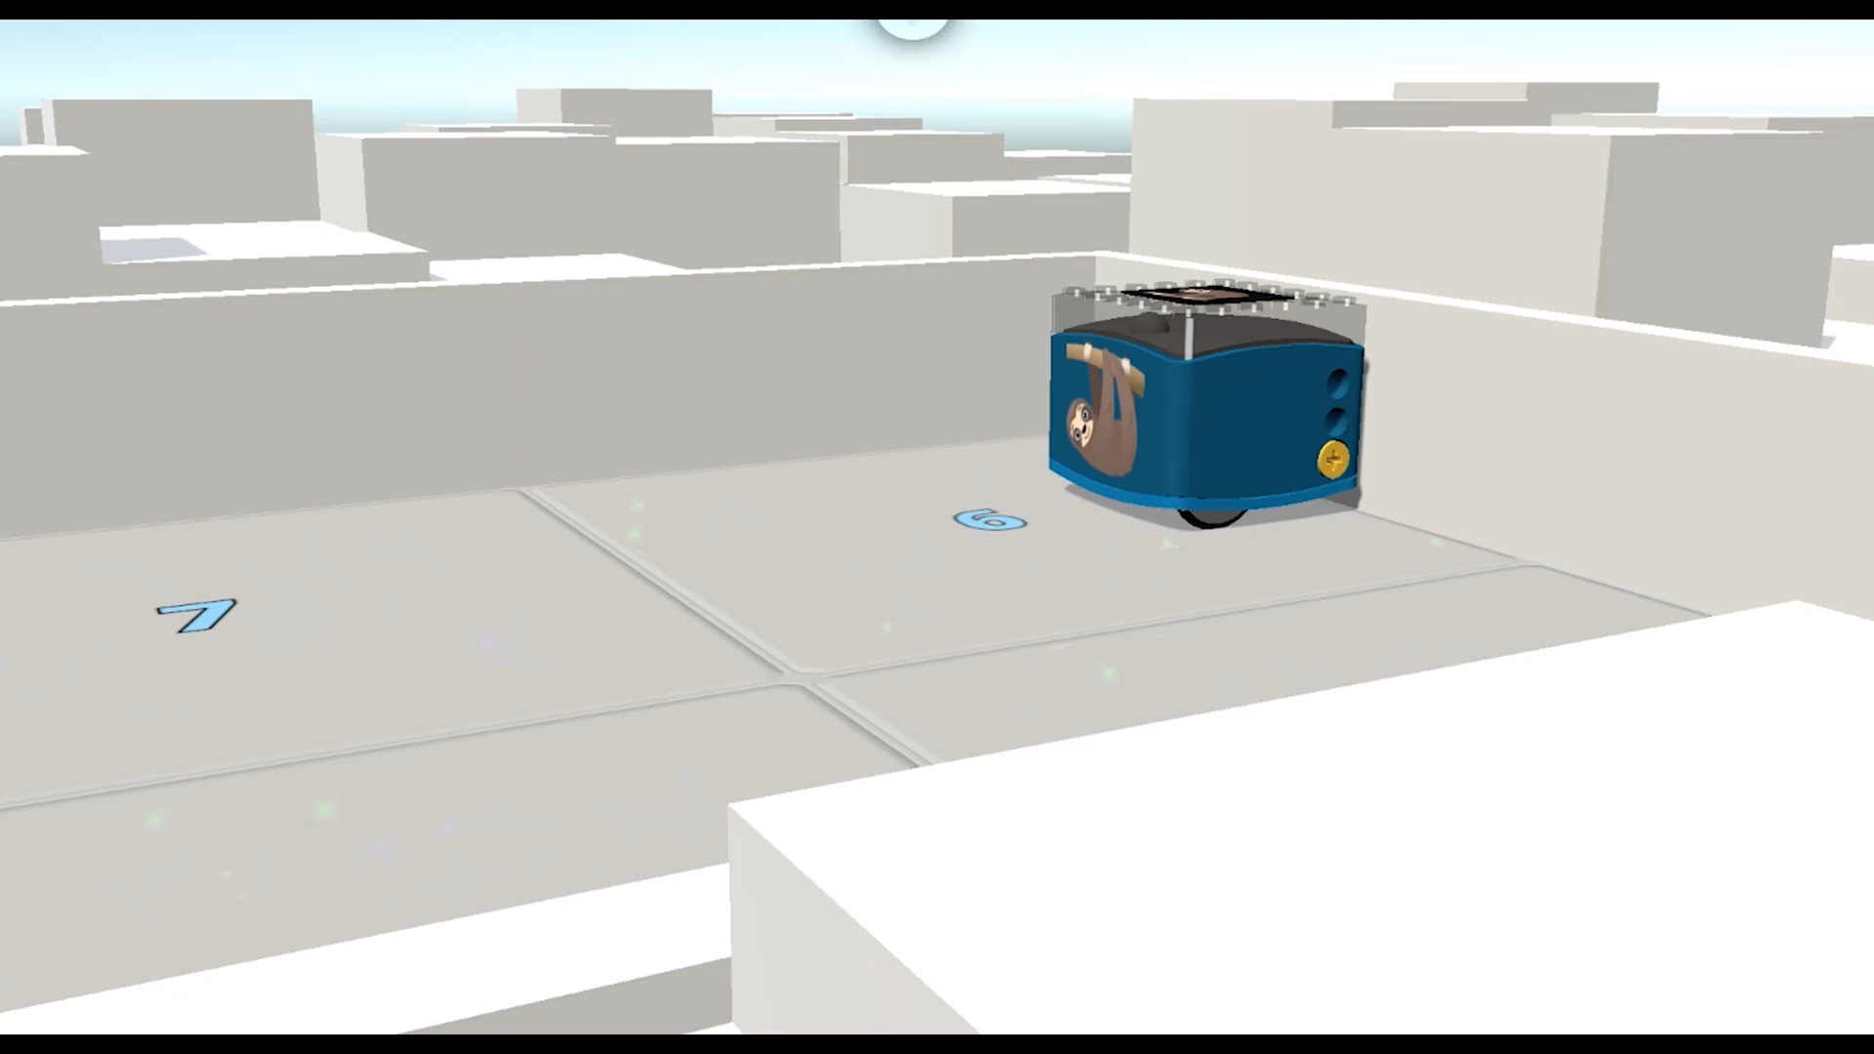
Through
Mathematical Thinking
And Game-Based Learning
CODING Workshop: Select “Slide Show” from the beginning. Click screen to advance.
For Grades K - 10
Rudy Neufeld
Math & Coding by Neufeld Learning
www.umathx.com

Slide 2
Rudy Neufeld, author/CEO at Math and Coding
by Neufeld Learning Systems since 1999
see www.umathx.com/about-us/
“Understanding Math”, UMathXI resource for K to 10 … 2005 to 2023
“Learning Math with Logo” … 1986
“First Steps in Coding to Learn” … 2022
“First Steps in Coding through Mathematical Thinking & Game-Based Learning” … 2023

Slide 6
SAMPLE PAGES

Slide 7
LESSON/COURSE OUTLINE
“First Steps in Coding Through Mathematical Thinking and Game-Based Learning” by Neufeld
Coding – An Introduction
Walking the Code
Coding KaiBot with Cards
Basic Screen-Free Coding
Advanced Screen-Free Coding
Screen-Free Coding within Lite
Screen-Free Coding to Block Coding
Advanced Block Coding
Ideas & Solutions in Advanced Block Coding
Game-Based Learning through Coding
Lesson Plans to Code Within Curriculum

Slide 9
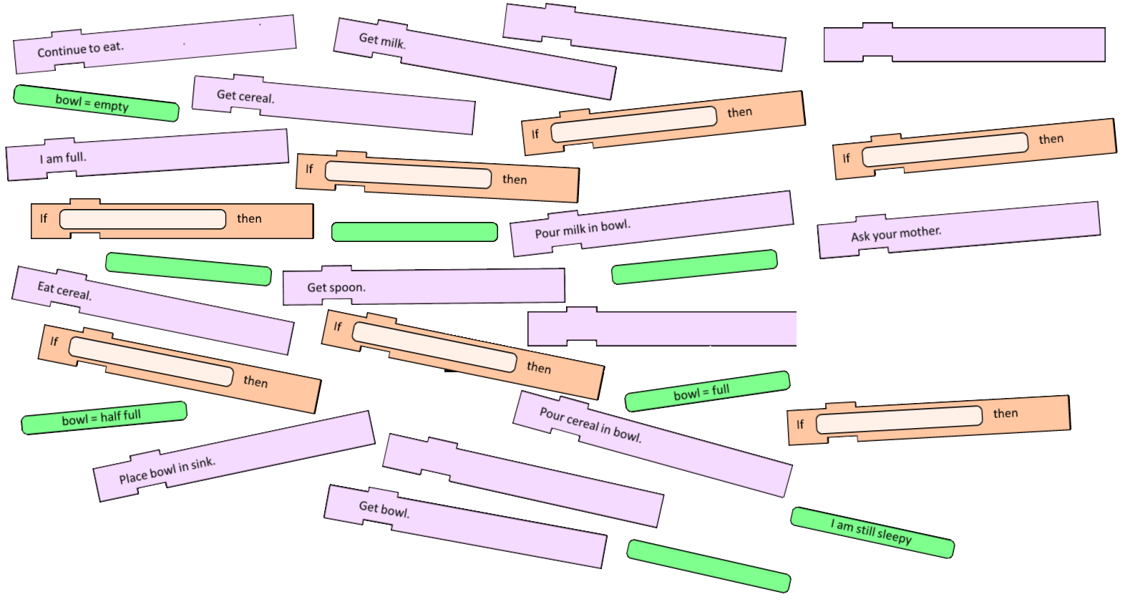
Coding – Introduction .. Sequence within Breakfast .. Ch 1.
We realize the importance of clear directions and of sequencing in ordering steps to plan our breakfast.

Slide 10
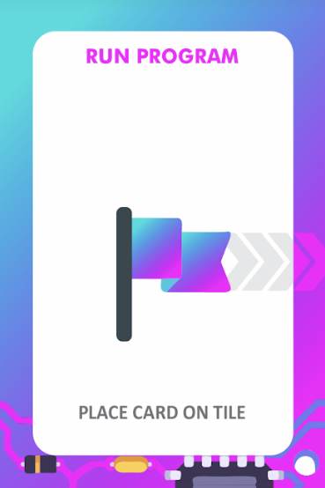
CHAPTER 2: WALKING THE CODE
We agree on 3 Special Cards in every sequence of code.
Always BEGIN every program with the card:
RECORD PROGRAM START
Always END every program with the card:
RECORD PROGRAM END
Always FOLLOW a program with the card:
RUN PROGRAM

Slide 11
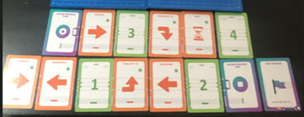
Learning takes place from the CONCRETE to the ABSTRACT.
Place cards on the ground or table in a specific sequence and then act out the commands.
KaiBot Coding Cards Template

Slide 12
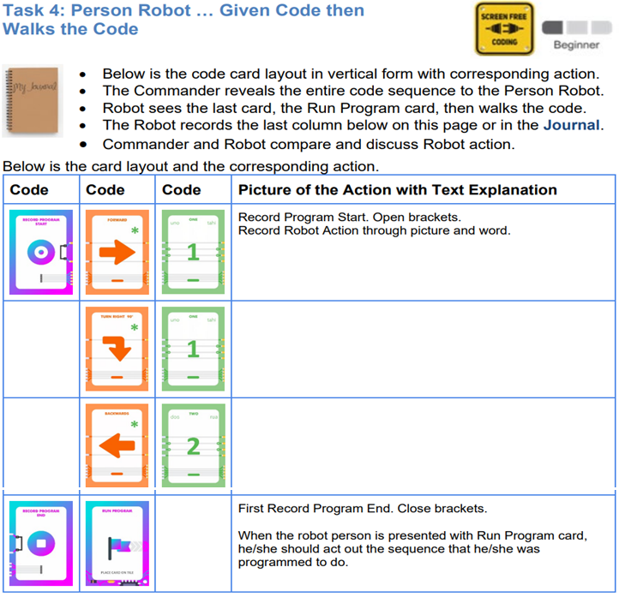
Ch 2, pg 23

Slide 13
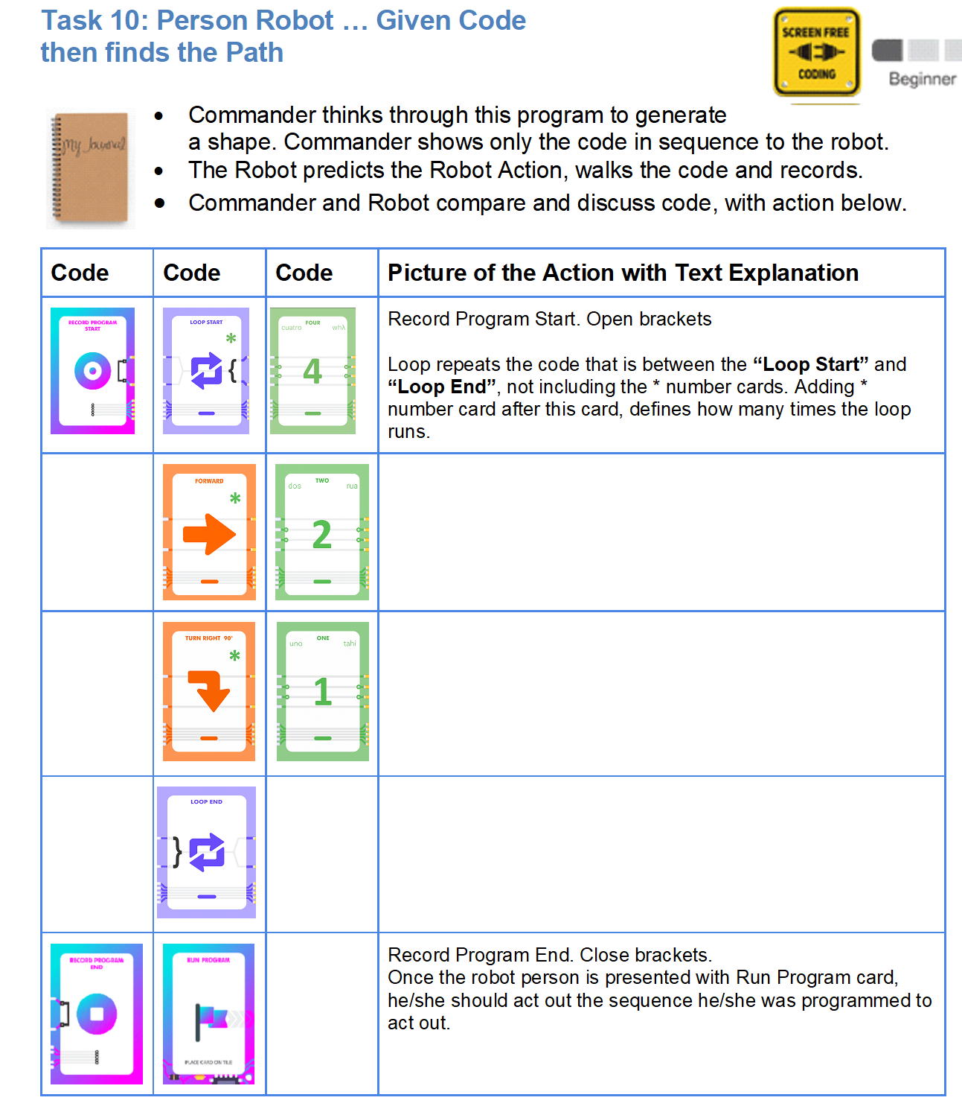
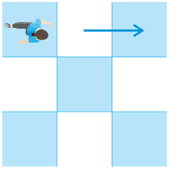
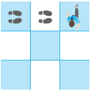
Ch 2 Pg 29
Loop repeats code between these cards.

Slide 14
Screen-free
(chapter 3) Coding KaiBot
with Cards
KaiBot scans and reads each card in the sequence.
Then KaiBot acts on specific code which results in corresponding action by KaiBot.
This gives us a great opportunity to …
LEARN FROM MISTAKES

Slide 15
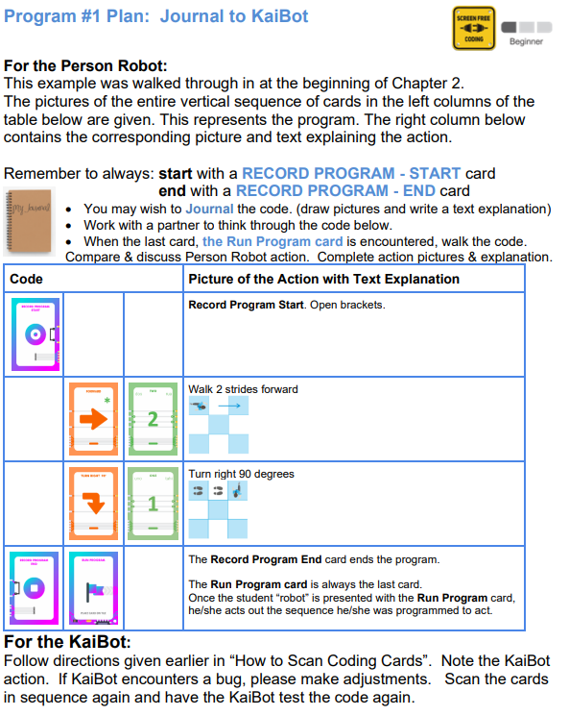

Slide 16
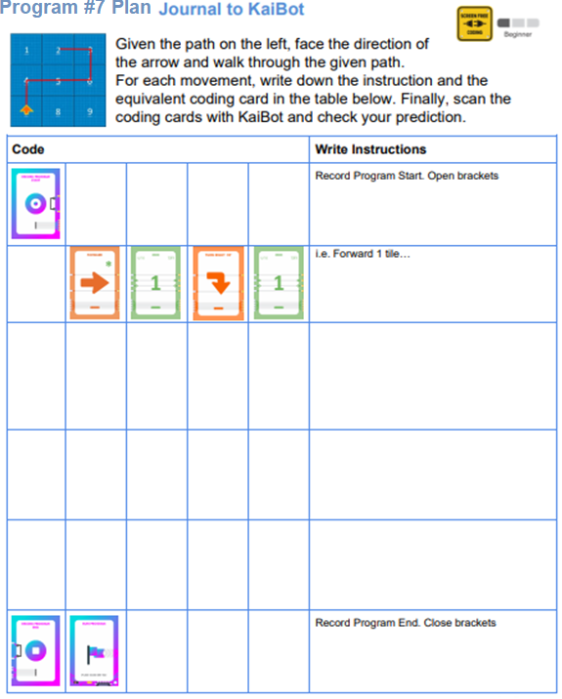
FIRST PREDICT THE CODE

Slide 17
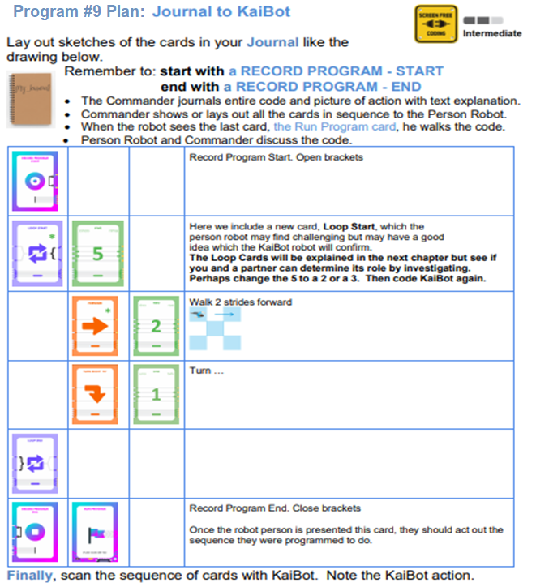

Slide 18
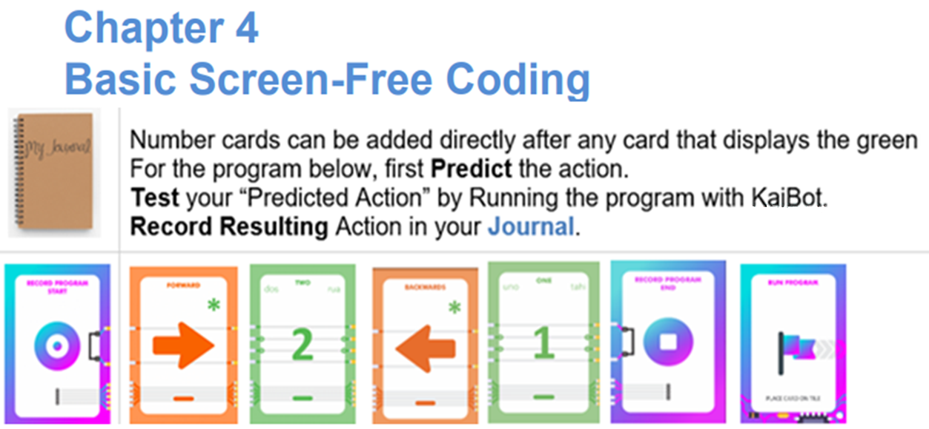
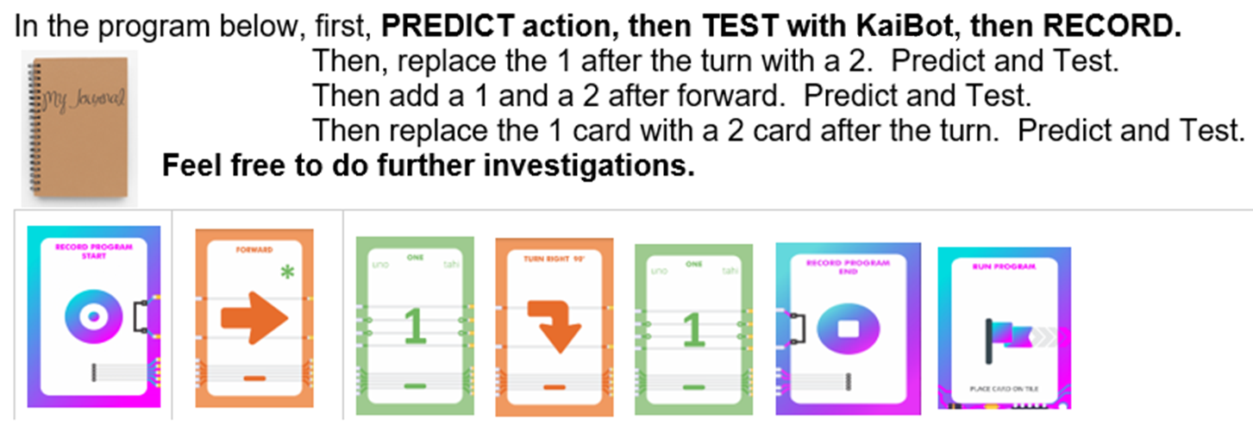
NUMBER CARD Pack and Investigation

Slide 19
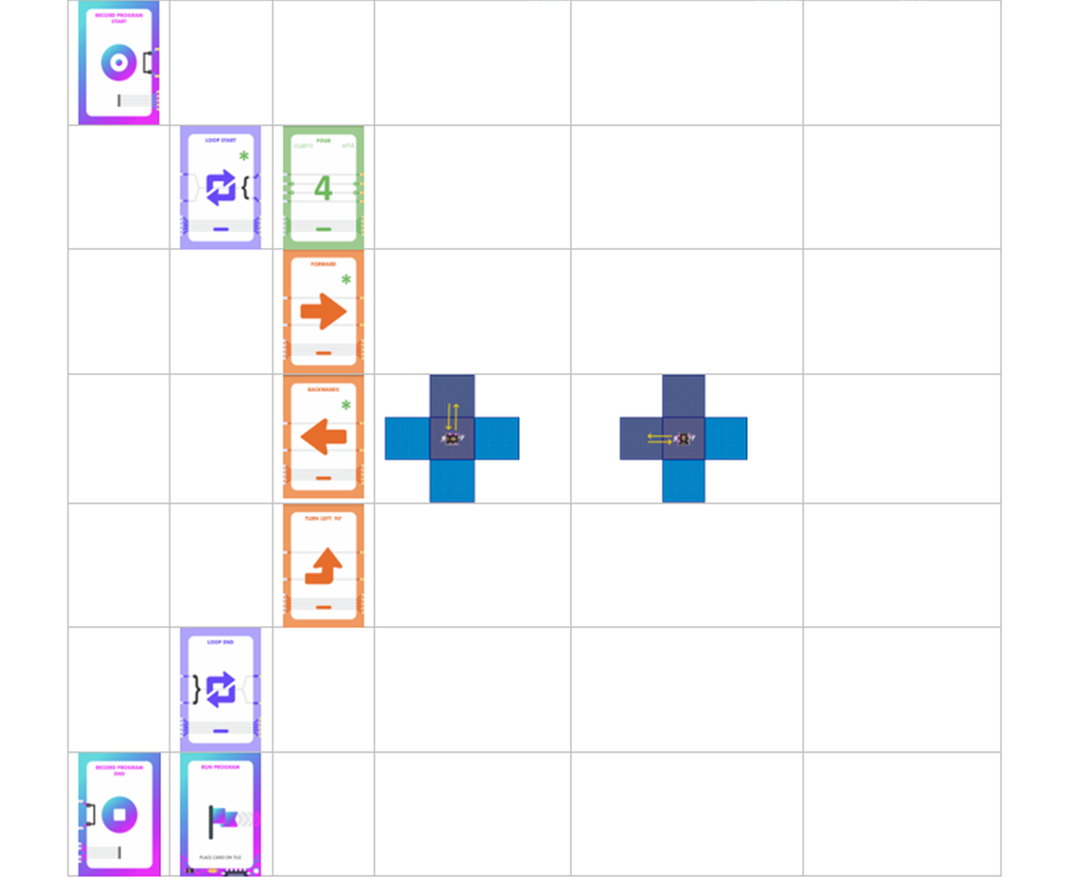
Ch 4
The CODE
Predict Action
(loop 1)
Predict Action
(loop 2)
Predict Action
(loop 3) … etc.

Slide 20
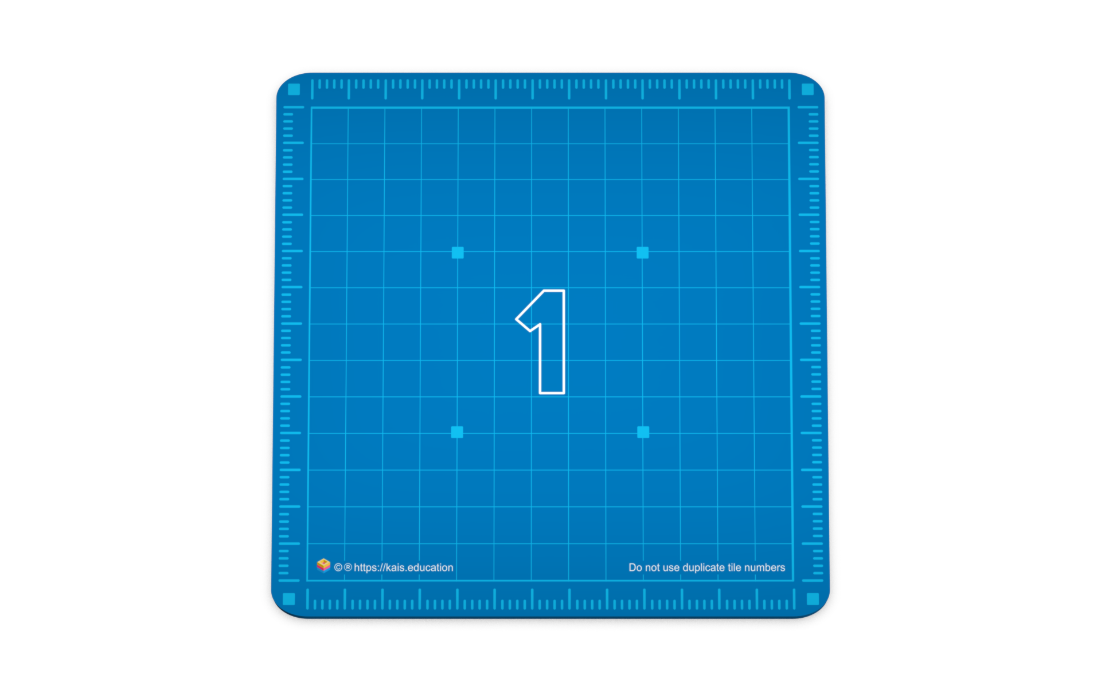
Hybrid: Use coding cards to code KaiBot and watch her in Kainundrum.
Build your own room layouts with KaiTiles
Magnetic snap together
KaiTiles correct location and direction of the KaiBot.
Every KaiTile is an XY Coordinate System. We are working to have the various XY Coordinate systems relate to one another.
Teach KaiBot to read your cards and then KaiBot will play back the actions on KaiTiles.
Use your coding cards to solve mazes
Add more KaiBots to join the race in multiplayer mayhem mode.
Video to Review
Sequence
How to Scan
Detecting Bugs
Charging KaiBot
Using KaiTiles
Be sure AUDIO is ON.

Slide 21
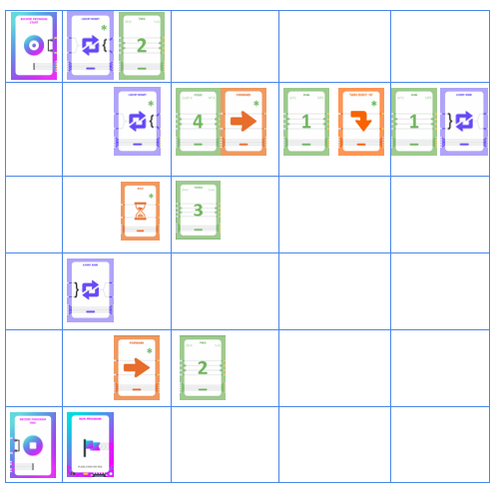
Chapter 4 … Exercise 13 Page 80
WOW .. LOOP within a LOOP!
You are given the program in coding cards.
We have organized the cards vertically in
order to help thinking through this example.
First Predict the action.
Test “Predicted Action” by running KaiBot.
Record the Resulting Action in your Journal.

Slide 22
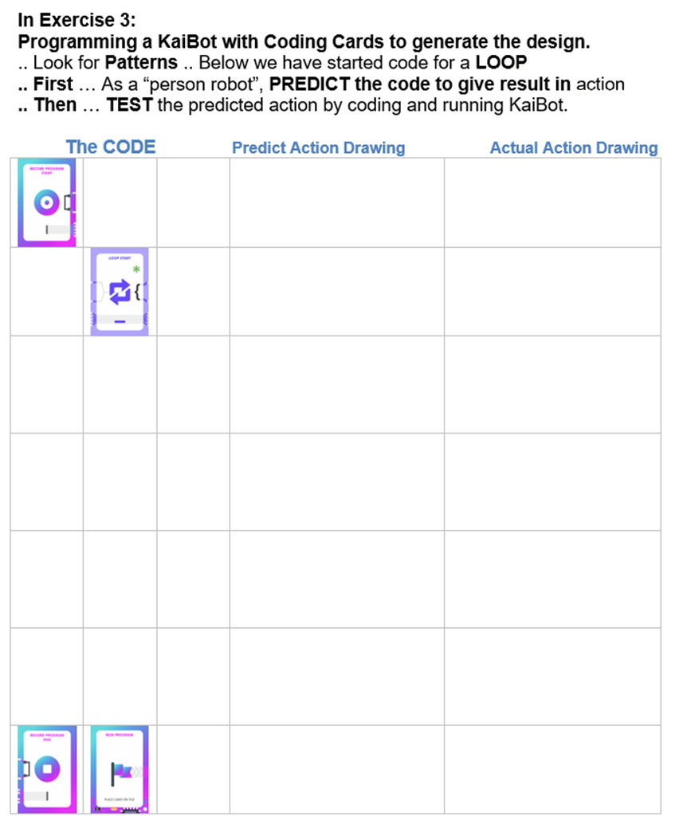
KaiBot Coding Cards Template
Ch 4, Pg 82
Code | Code | Code | Draw Sketch and write Instructions
 |  |  | Record Program Start at tile #1. Open brackets
 |  |  | Move 2 Tiles Forward
 |  |  | Turn 90 degrees right
 |  |  | Move 2 Tiles Forward
 |  |  | Backwards …
 |  |  | Turn left …
 |  |  | Move backwards …
 |  |  | Move
 |  | ???? Must a Number Card be here?
 |  |  | Record Program End. Close brackets Once the robot person is presented this card, they should act out the sequence they were programmed to do.

Slide 23
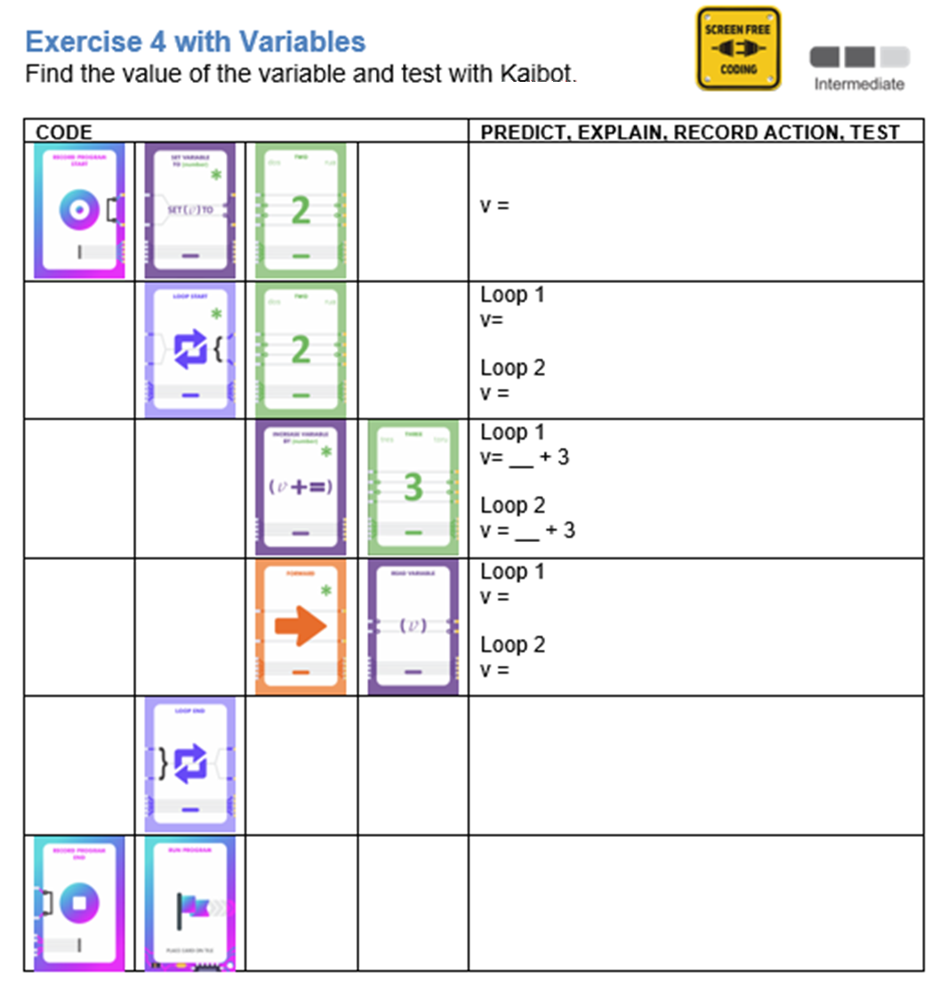
Chapter 5
ADVANCED SCREEN-FREE CODING
Page 92

Slide 24
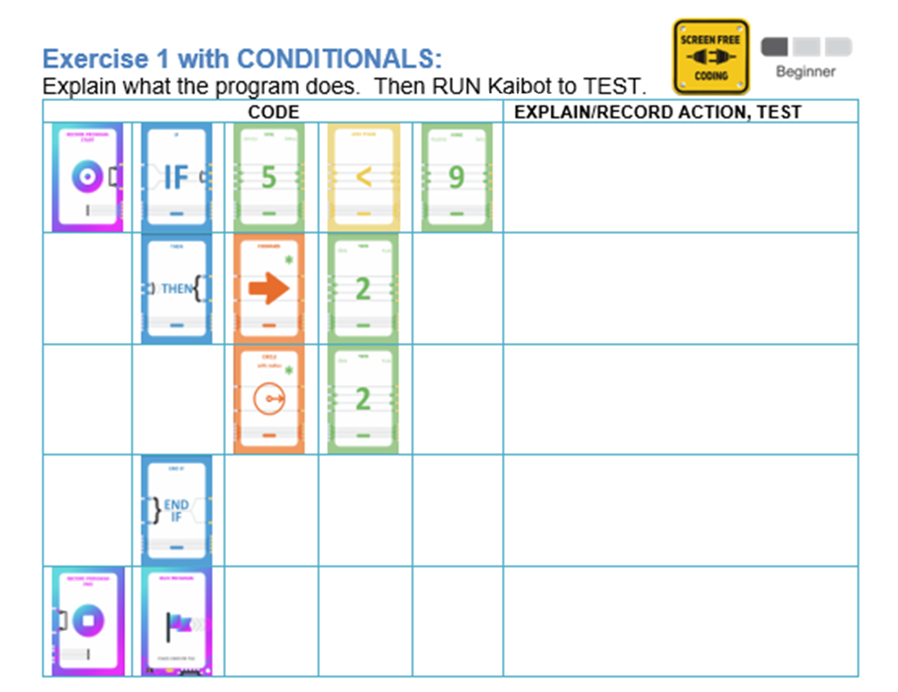
Chapter 5
Page 98

Slide 25
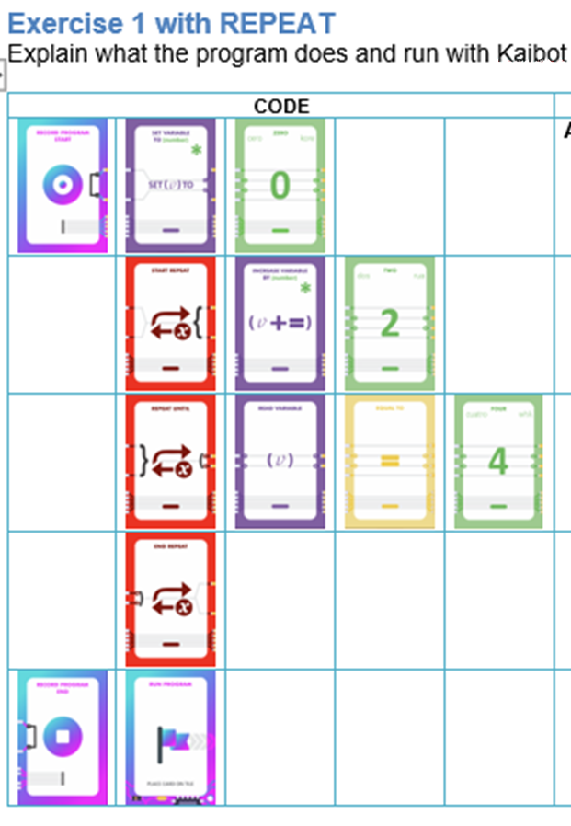
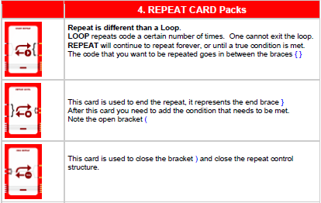
Ch 5, Pg 105, 106
**You will need to add some movement commands for
KaiBot in order to test your thinking.

Slide 26
Ch 5, Pg 112
See Ch 5 page 115 .. Function Exercise 2
.. A more substantial exercise with Function.
We have made it available on our website
www.umathx.com as part of selected sections
in the eBook that were made available for users.

Slide 27
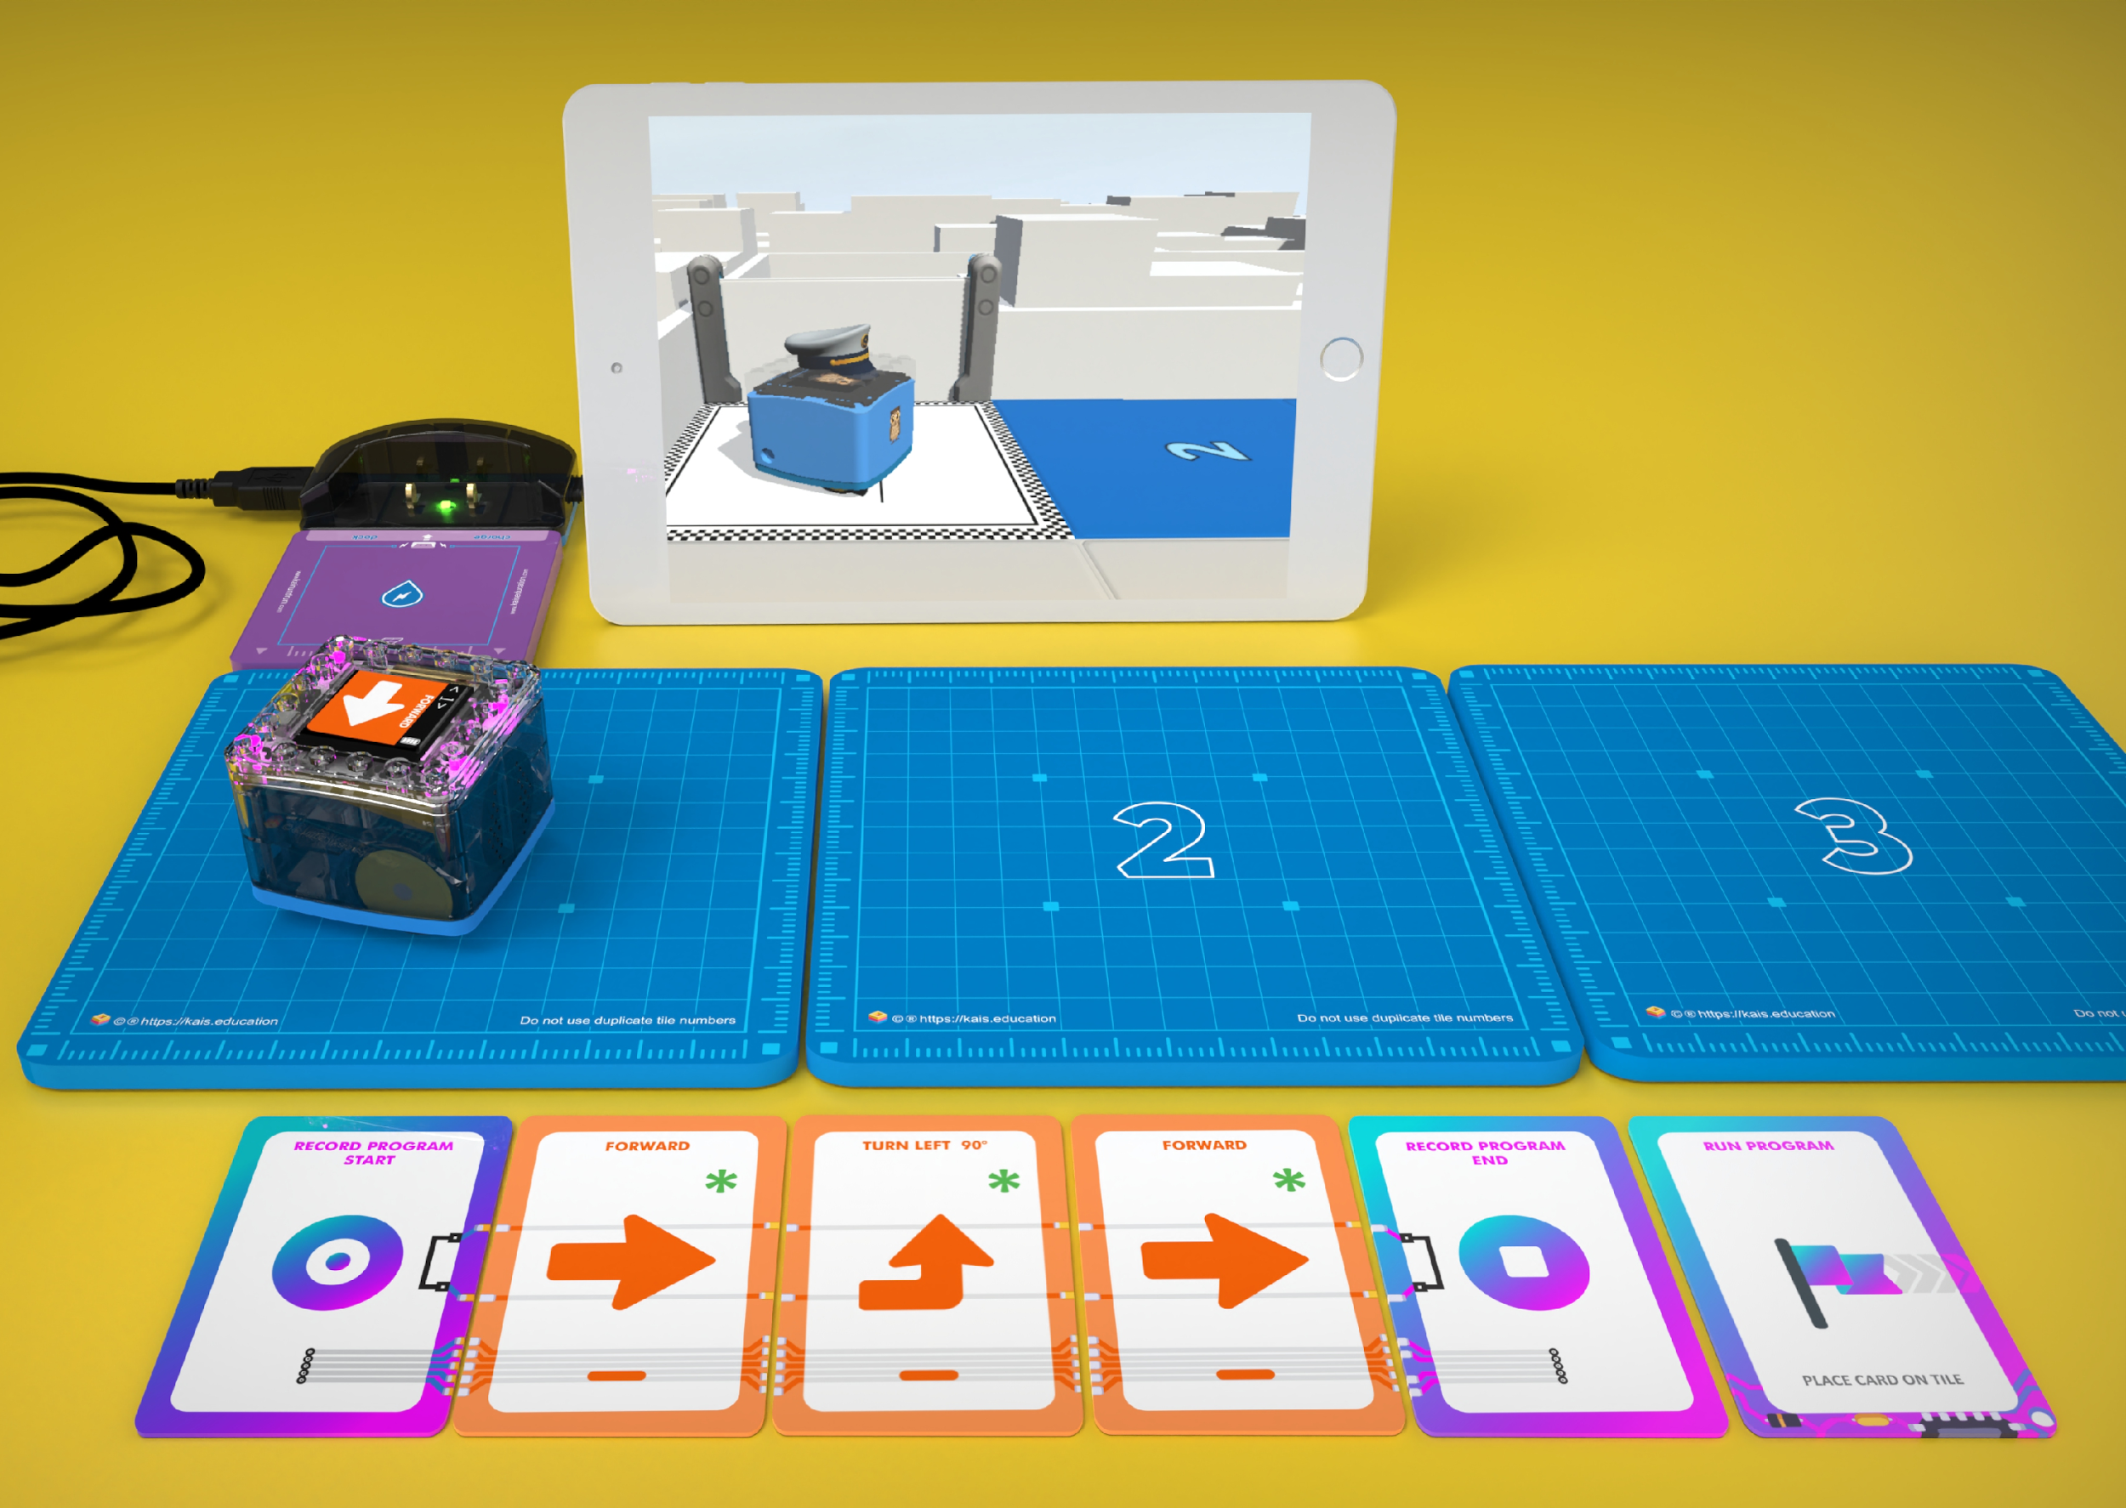
Chapter 6: : Screen-Free Coding within Lite
KAINUNDRUM LITE is an app that works with KaiBot, coding cards and the magnetic KaiTiles as a FIRST STEP from PHYSICAL to ABSTRACT.
In Kainundrum Lite, the virtual viewer matches the physical KaiBot on the tiles. All coding is done through KaiBot and the Coding cards.
Designed for tablets for iOS, Android and Chromebook

Slide 28
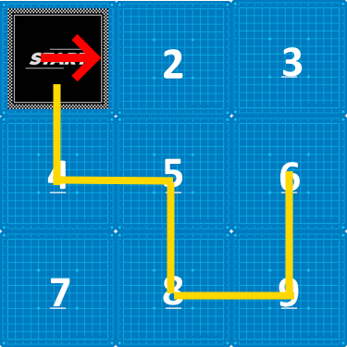
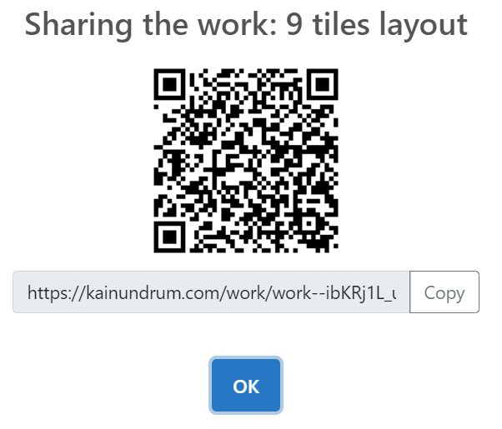
LITE EXERCISE 3: Determine Code from Path
Given the path on the image above.
Write down the instructions and equivalent coding card for each movement in the table below. Look for patterns resulting in a loop. Then scan the QR code for the project above and build the physical layout.
Program the code using the coding cards and place KaiBot in the direction of the arrow as shown above and run the program alongside the app. Check to see if your KaiBot travels the same path as the image displayed above.

Slide 29
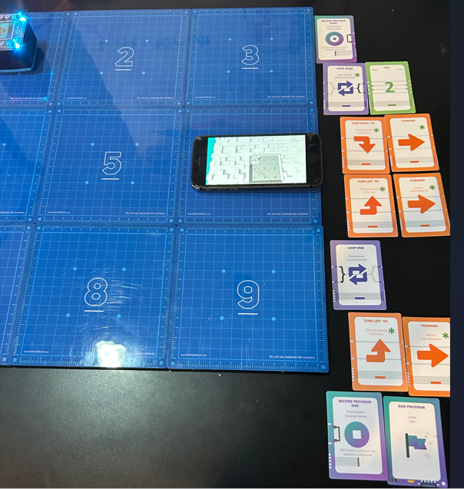

Slide 30
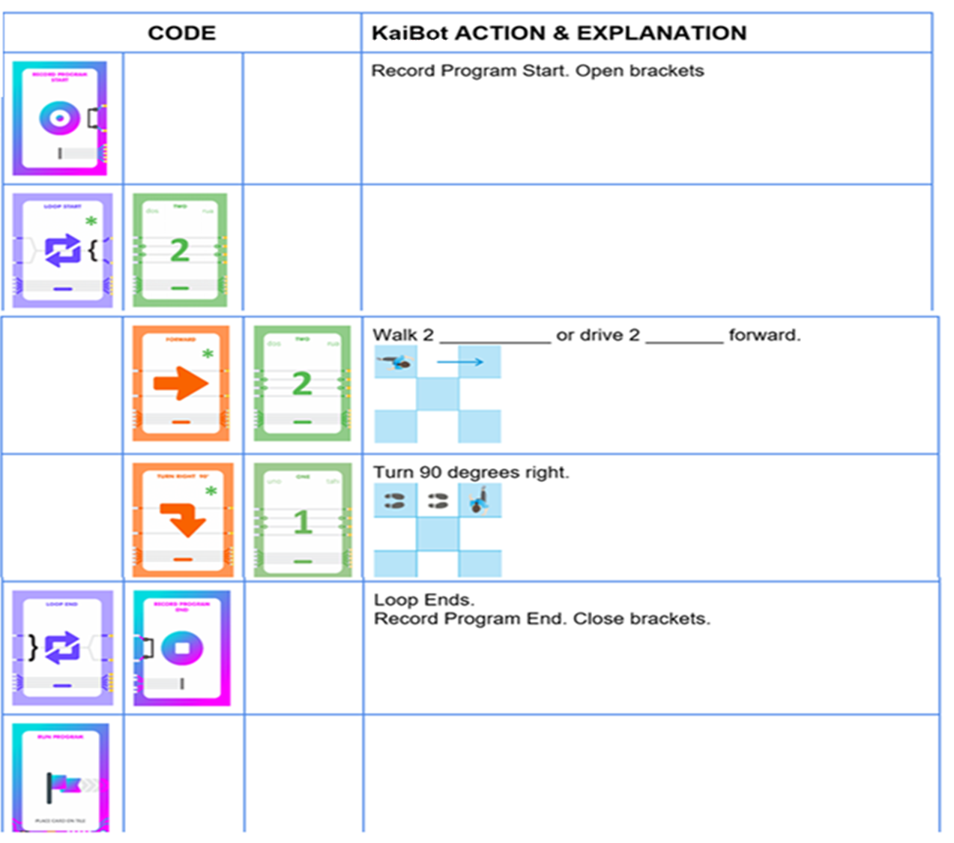
IN PREPARATION for the next slide, arrange your cards as indicated to the right.
We will SCAN these cards with a KaiBot on the next slide.

Slide 31
Chapters 7, 8 ,9 … Coding from Concrete to Abstract
Ch 7 .. Cards & KaiBot to Block Coding
Ch 8 .. Advanced Block Coding
Ch 9 .. Ideas in Advanced Block Coding
1. On Computer go to http://www.kainundrum.com or ..
https://kainundrum.com/work/work--dHapQj1tZt-HO2wG5xRG_5MM4nD8oZMY
(for prepared match)
2. Match tile layouts .. KaiBot start .. Concrete on KaiTiles .. Virtual in Kainundrum
3. Save
4. Pair KaiBot with Kainundrum by Bluetooth
5. Click on Start
6. Create a program by KaiBot scanning coding cards (see previous screen)
7. After Scanning KaiBot, program converts to Blockly & Python in Kainundrum ... KaiBot acts the code on KaiTiles & mirroring in Kainundrum
After Scanning, user can run the program:
..by Cards to KaiBot (Concrete Action)
..by “Run Program” at the top of the Blockly Screen
If tile layouts .. Concrete and Virtual .. are NOT matched, then Running Program in Blockly results in action ONLY on the 3D Virtual Screen.
for prepared match

Slide 32
IN REVIEW
Kainundrum to
Blockly & Python
If the Virtual and Physical Tiles are an EXACT MATCH .. then
Once you scan KaiBot on the “Record Program End” card, KaiBot will send the program through to Kainundrum.
Then in Kainundrum, the program will be converted to Blockly and to Python text code.

Slide 33
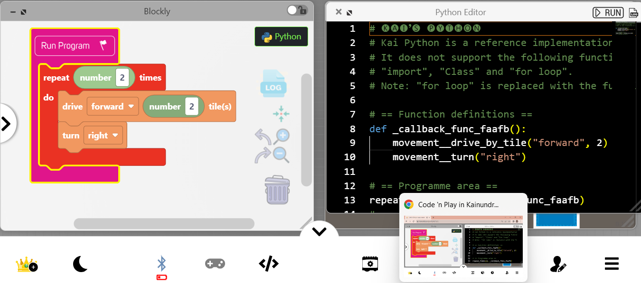
IN REVIEW
NOTE: From here to end of presentation are all
possible to be done without the KaiBot (at no cost!)

Slide 34
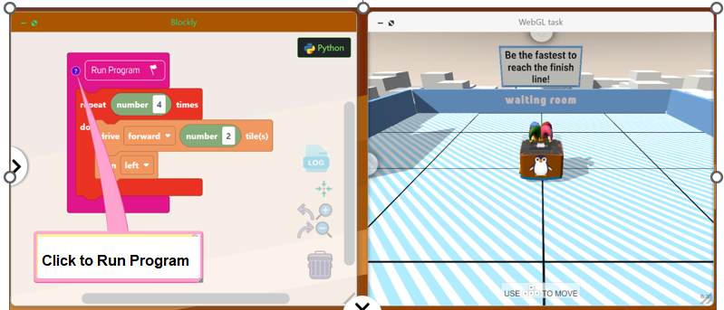
IN REVIEW
If you DO NOT have the same tile setup on the KaiTiles and in Blockly, then movement will NOT be mirrored.
… however the result is acted out in the virtual 3D window

Slide 35
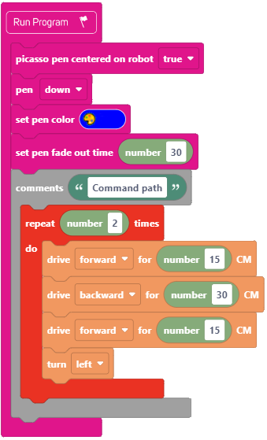
INVESTIGATION #20: Path to Code in Blockly Write Code in Blockly to result in the following graphic. Then test your work by running the program.
REPEAT DEMO OF OPTIONS HERE …
Ch 7 .. Page 185
Demo options here:
If virtual and physical
Tile setup are the same.
2. If virtual and physical tile
Setup are different.
Set up the Kainundrum Learning Environment.
On computer … www.kainundrum.com
Or with a virtual saved tile arrangement …
https://kainundrum.com/work/work--dHapQj1tZt-HO2wG5xRG_5MM4nD8oZMY

Slide 36
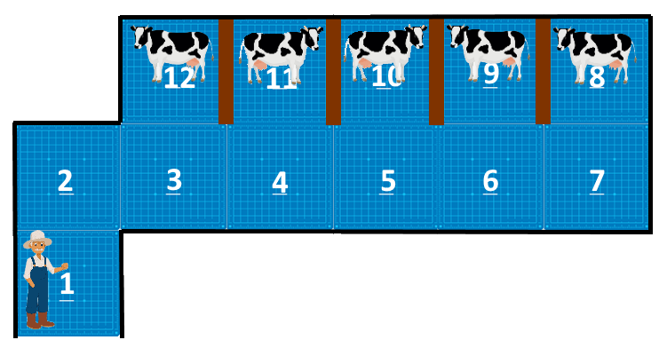
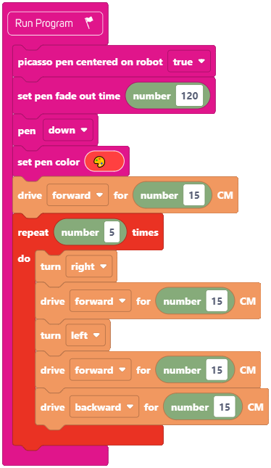
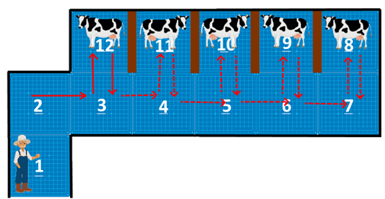
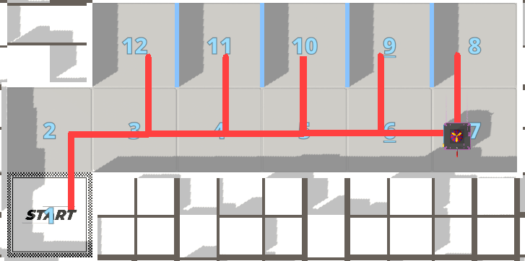
LOOP INVESTIGATION #8: Milk the cows
Every morning a farmer milks his cows in his barn. Each cow is in its own separate stall, as shown below.
By looking at the image layout, we want to look for repetitive movements that can be used in a loop.
The movements that are repeated to milk each cow are noted on the left.
For 1 iteration, the farmer must turn right, step forward, turn left, step forward and step backwards. This is repeated 5 times.
In Kainundrum …

Slide 37
Game-Based Learning through Coding … Chapter 10 Within Kainundrum at www.kainundrum.com Create and Solve a Game through Coding.
Kainundrum is an innovative, exciting, game-based platform that will also let players unleash their creativity and puzzle solving skills through designing and playing games.

Slide 38
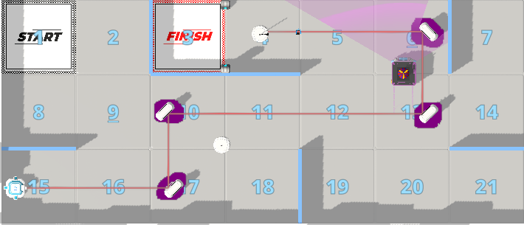
Create and Play a Game: Game 4: Maze Project 4 Ch 10 page 306
One must utilize a laser and mirrors to bend and direct the laser beam around to pop a balloon to open the gate to the finish. Checkpoints will be added for the user to trigger in order to win the game.
https://kainundrum.com/work/work--zuqQzthzocDP7hvihjxqYzbT-9JCeShu DEMO This.

Slide 39
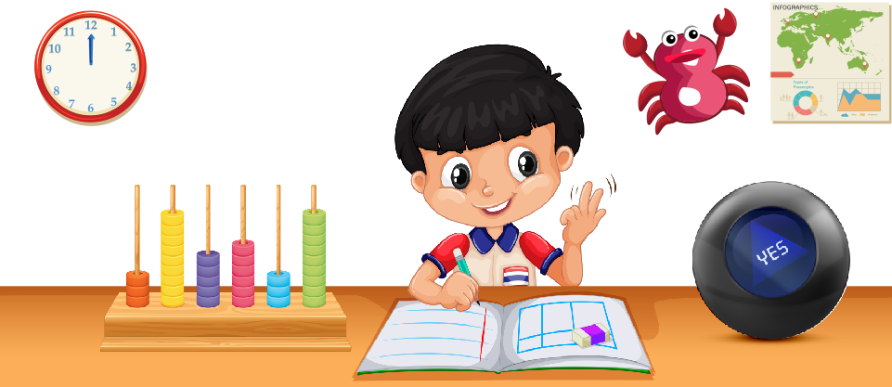
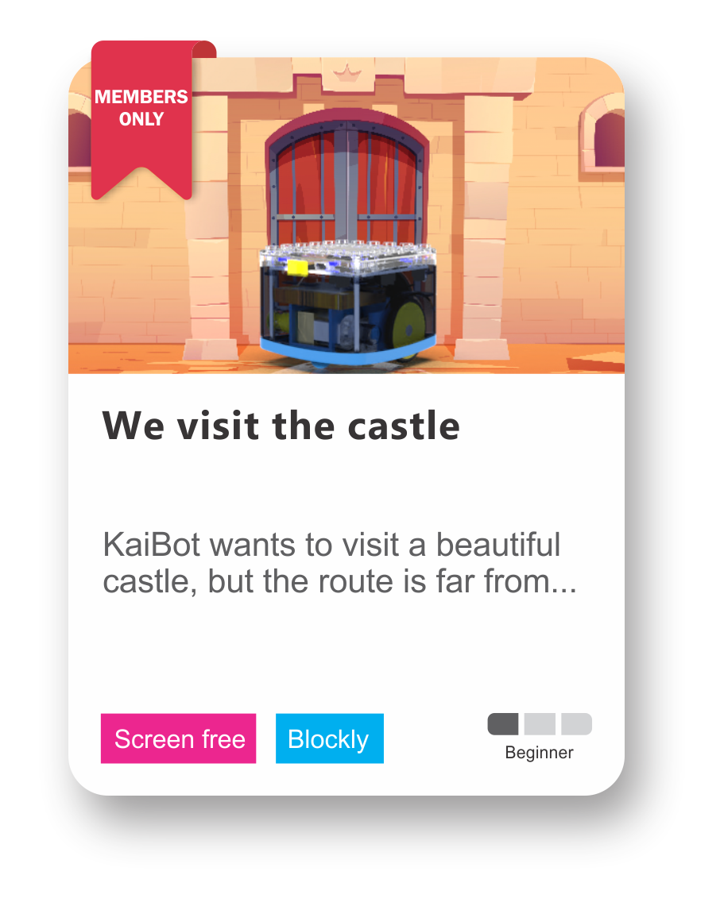
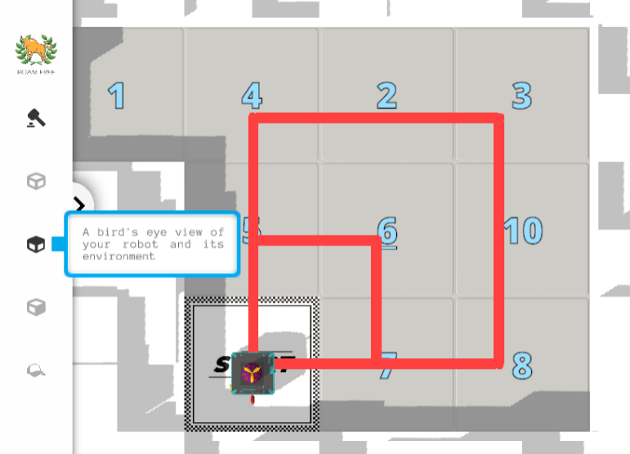
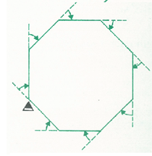
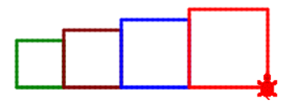
Chapter 11.
Lesson to Code
in Curriculum. (pg 319)
Tutorials to get started
Lessons catered to beginners, intermediate and expert.
On making 8
DEMO This.
Variables
Patterns, Patterns
Click on the link: Analyze Code and Variables in Chinese Nested Boxes
https://kainundrum.com/work/work--BwYcIPH3L0zbPBnn9wAFR_PUvLpVzlfj
Greater Than

Slide 40
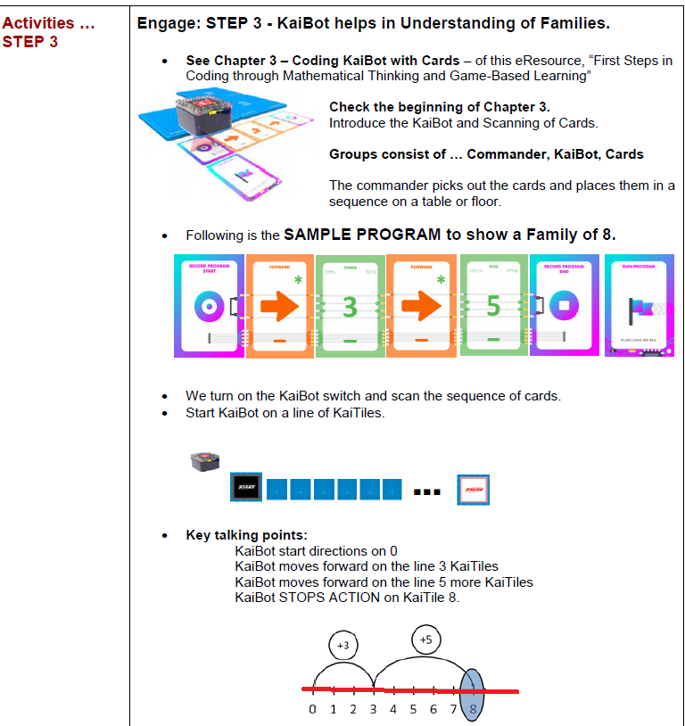
Elementary Curriculum
Chapter 11, Page 319

Slide 41
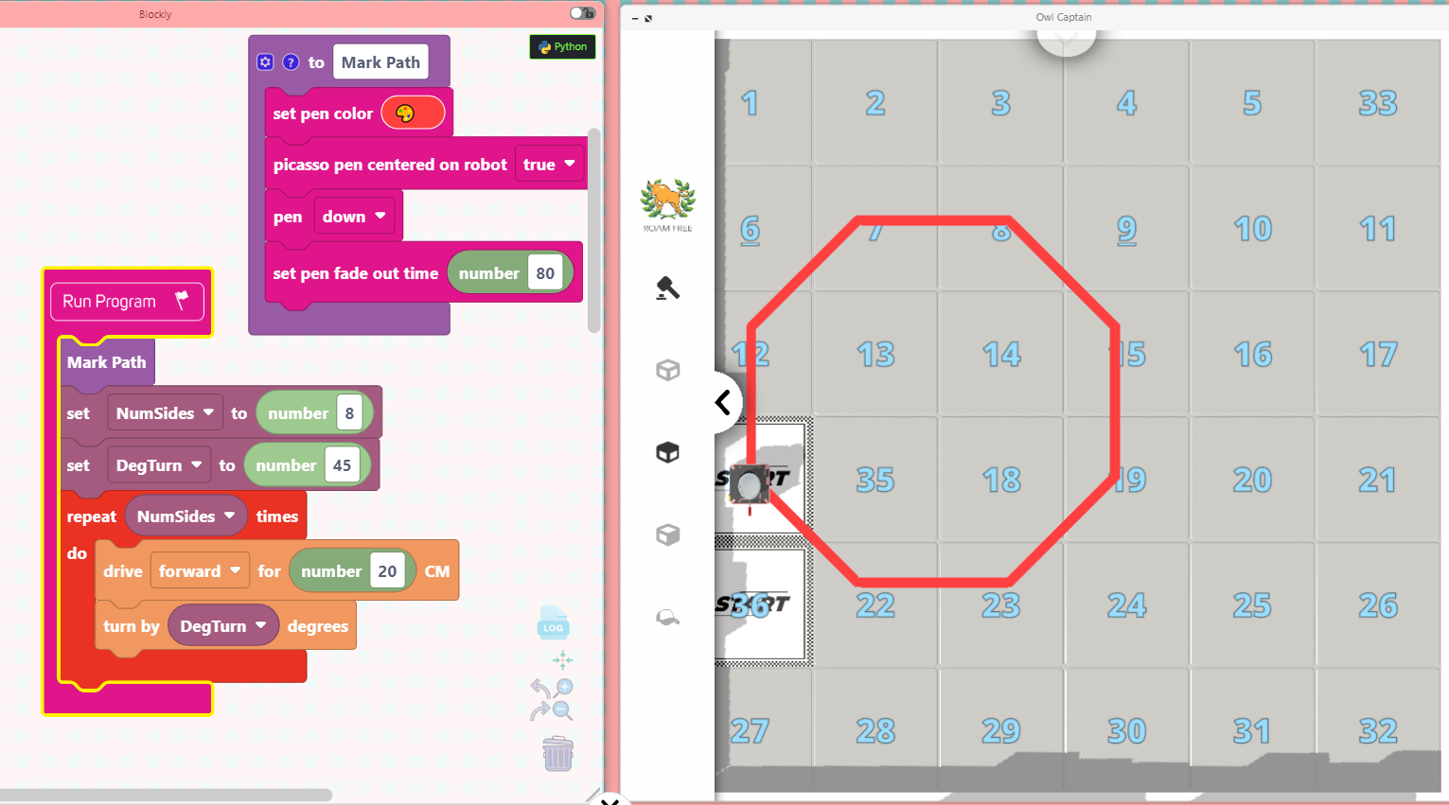
THE POLYGON .. CHAPTER 11 …
BUILD THIS WITH THE GROUP .. TO UNDERSTAND BLOCKLY CODE

Slide 42
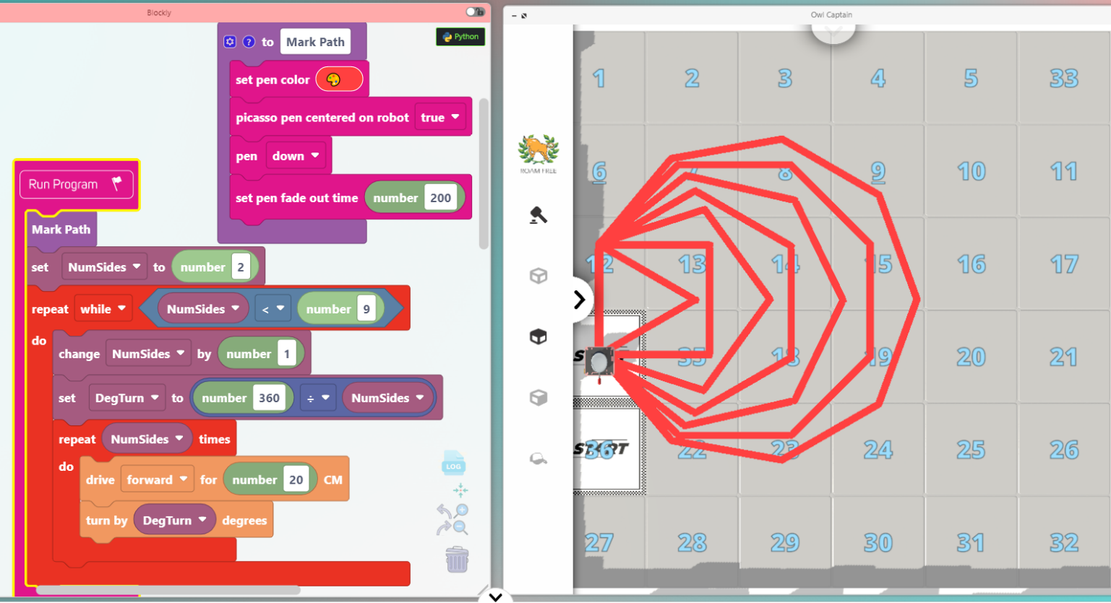
MANY REGULAR POLYGONS .. Ch 11 pg 353
Now show BLOCKLY
http://www.kainundrum.com/

Slide 43
Products… https://www.umathx.com/shop
Single KaiBot, Charging Dock, Coding Cards
Advanced coding card deck
100 different cards from Movement, Logic, Numbers, Loops,
Variables etc.
Magnetic KaiTiles
Packs of 10 for KaiBot movement accuracy.
Lesson Plans for K to 8
PREVIEW at www.umathx.com
Screen-Free: With Coding Cards and KaiBot
Virtually: Involve Blockly .. Select from
Movement, Logic, Numbers, Loops, Variables etc.
http://www.kainundrum.com
Note FREE TO PLAY with virtual robots and blockly
VIDEO OUTLINE ... KaiBot in Kainundrum ... First Steps in Coding
An excellent summary
Be sure AUDIO is ON.

Slide 44
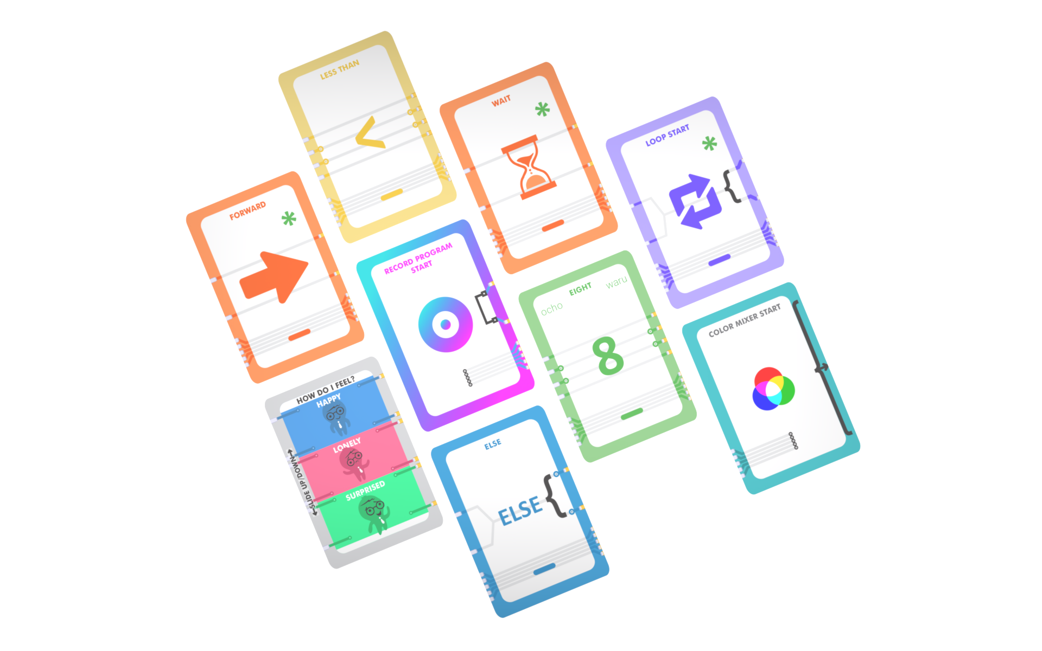
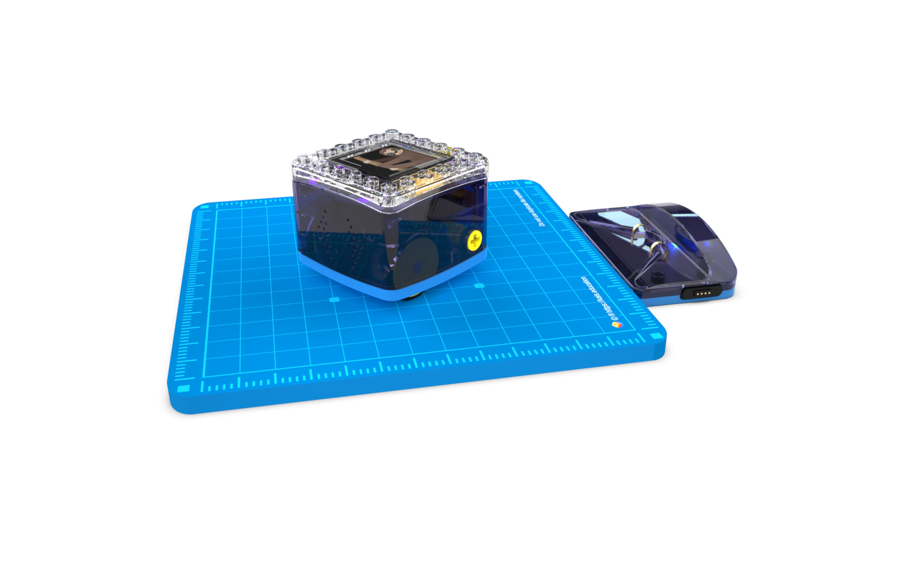
NEED HELP … Marketing/Education
Go to www.umathx.com for this power point, sample exercises & lessons for K to 8 in the eBook.
A DEMO PACK in JUNE?
Marketing Needs around the world.
IF INTERESTED:
Contact me personally at …
rudyneufeld@umathx.com
KaiBot in Kainundrum by associates in New Zealand, as well as our
350 page lesson resource are now in 5 continents.
My team and I offer all - teachers, students, schools, districts - resources, support and lessons written to make a coding curriculum come alive.
For more information, click on the graphic link to the left.

