Slide 1
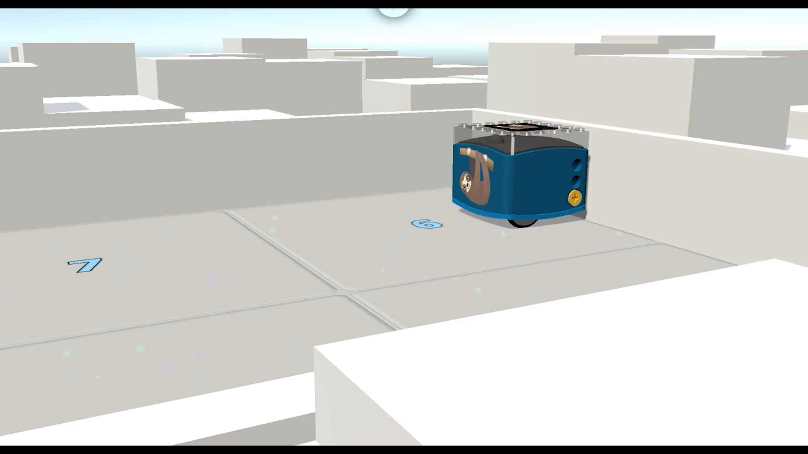
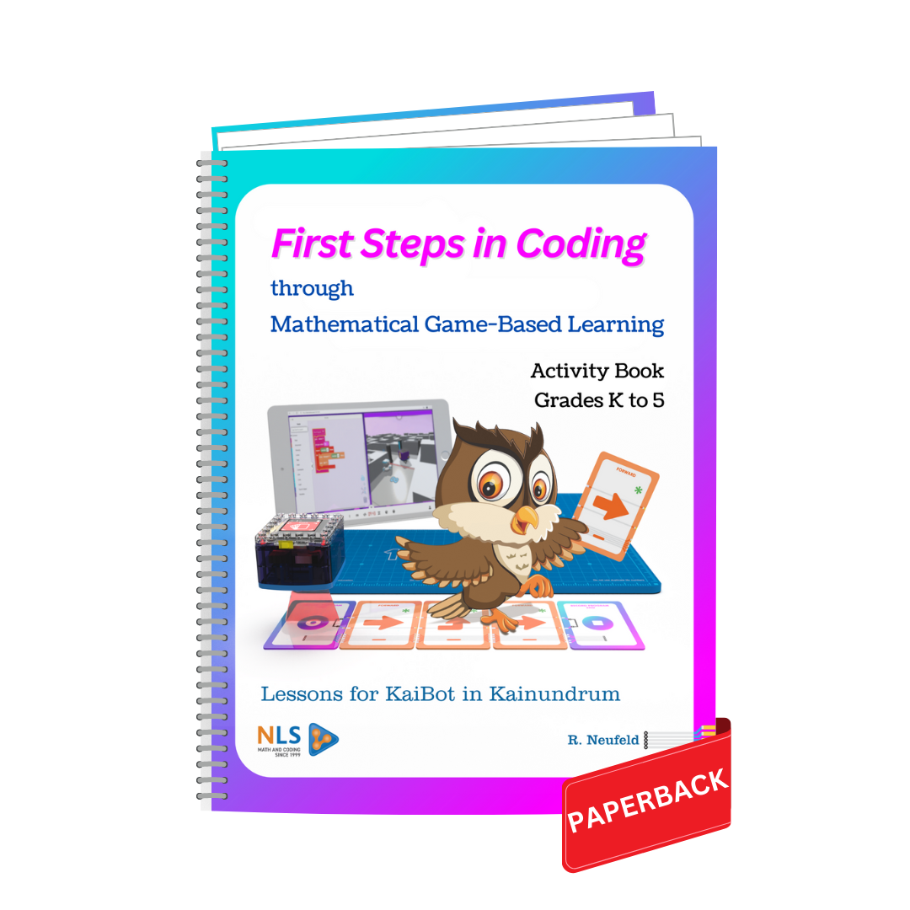
Through
Mathematical Thinking
And Game-Based Learning
CODING Workshop for Grades 2 to 8
Select “Slide Show” from the beginning. Click screen to advance.
BEGIN by CLICKING HERE
Rudy Neufeld
Math & Coding by Neufeld Learning
www.umathx.com
Notes:
*

Slide 2
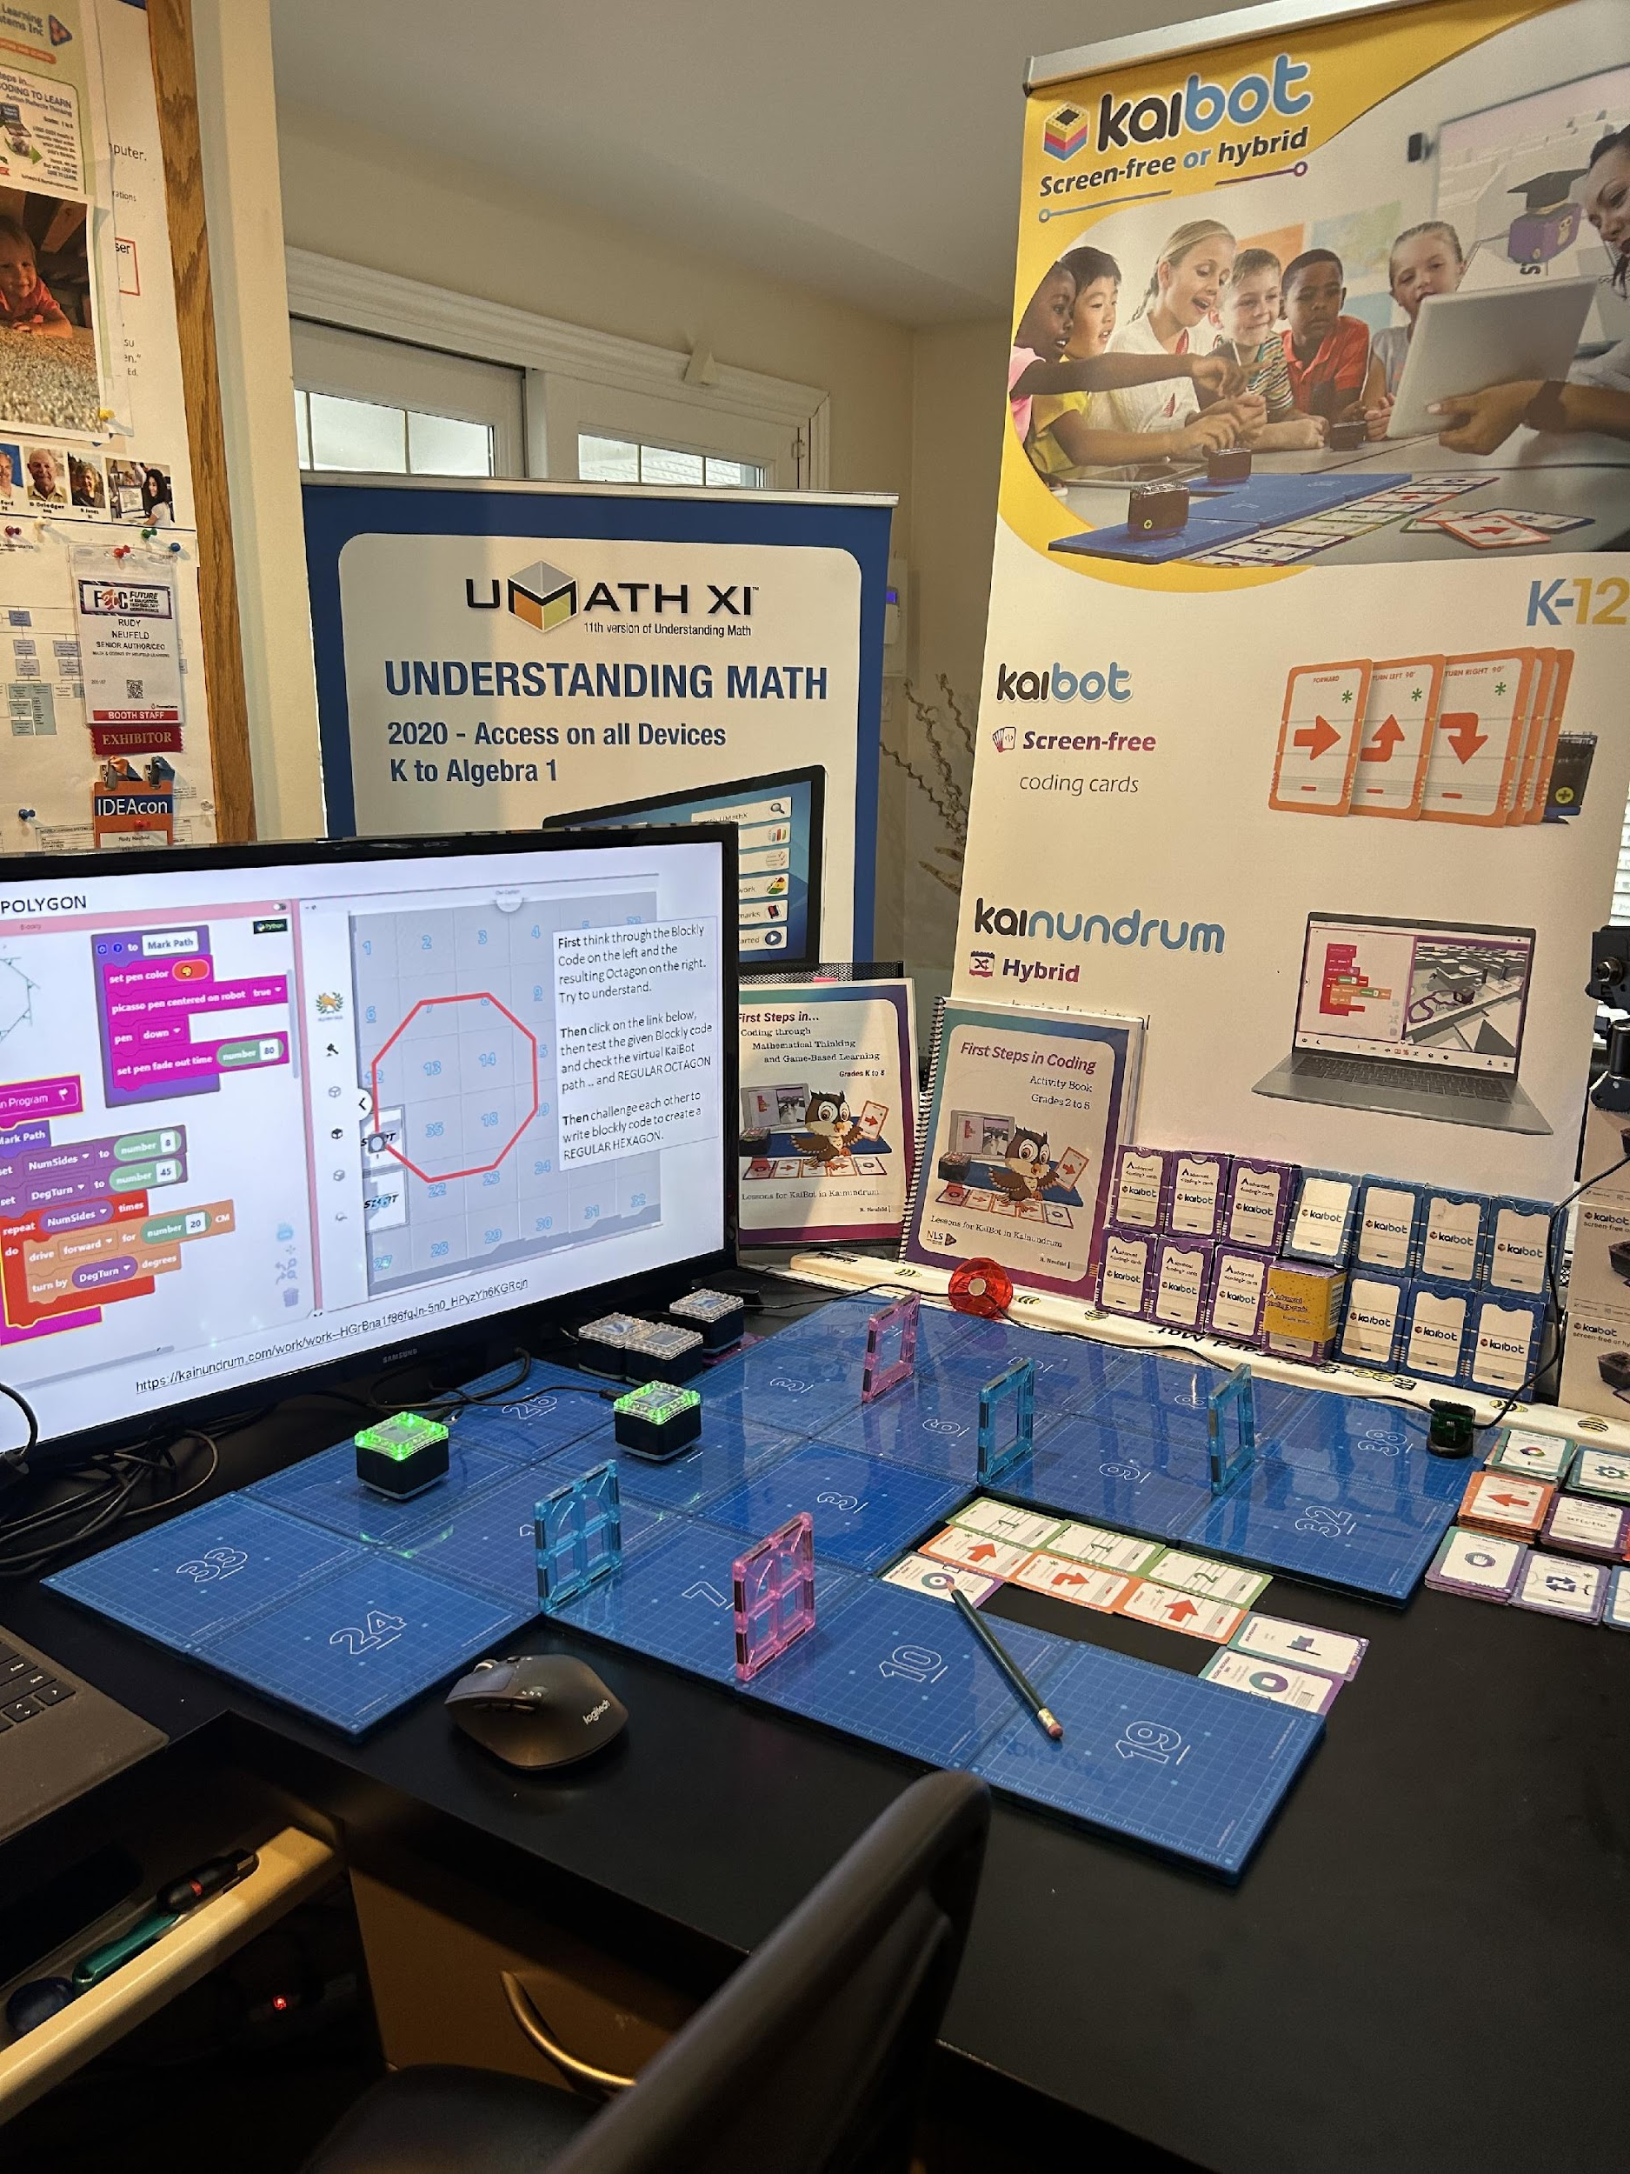
Neufeld Learning Systems Inc.
Office for presenting Webinars
www.umathx.com
rudyneufeld@umathx.com
1 519 657 9334
Where Are We?

Slide 3
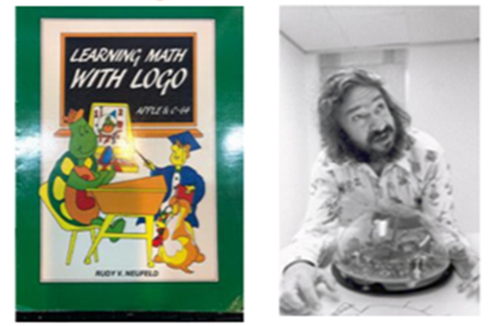
Two Influences
1985 –Dr Seymour Papert at MIT
Papert … Pioneer of Artificial Intelligence.
… Developed a powerful coding language, LOGO.
LOGO models a Learning Environment which
encourages one to TEACH rather than simply to TELL.
LOGO is referred to as the Language of Learning.
2022 – Bruce Jackson, Kai’s Education … New Zealand
the concrete … Act out code on coding cards.
the concrete … Teach KaiBot. Scan coding cards.
to the abstract … Block-based coding to python.
Notes:
*

Slide 4
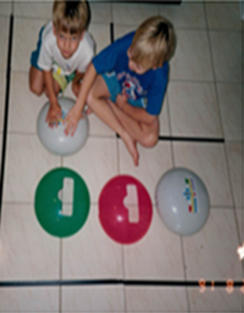
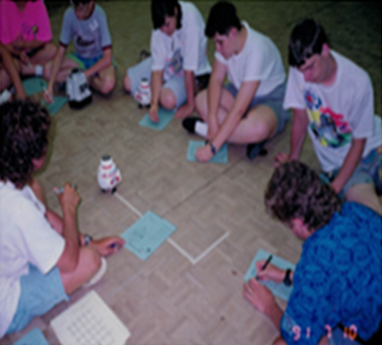
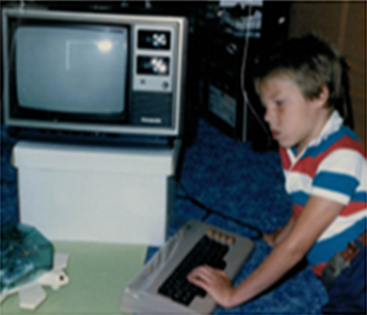
Robots create an environment for risk-taking & learning from mistakes.
A mistake is an “opportunity to learn”.
Robots “engage minds in rich, exploratory, open-ended enquiries”.
Notes:
*

Slide 5
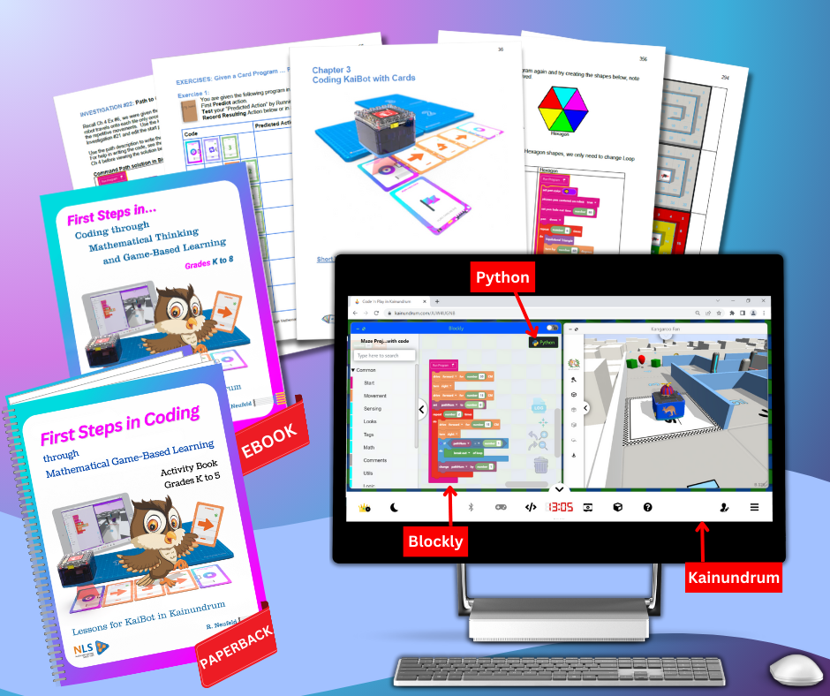
Student Activity Book
K to 5
PREDICT and RECORD
JOURNAL
Teacher Resource
K to 8 eBook
Paperback Preview
Notes:
*

Slide 6
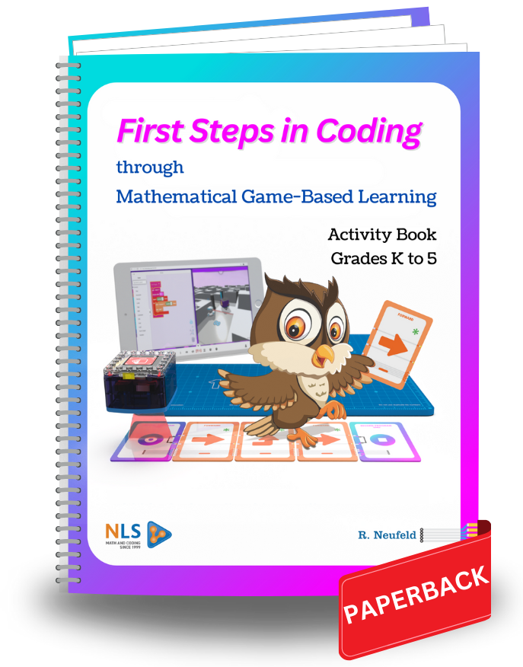
Course Outline – “First Steps in Coding”
(Correlated with CSTA, TEKS and Ontario Coding/Computer Science Curricula)
Coding – An Introduction
A Person Walks the Code
Screen-Free Coding – Steps & Turns
Screen-Free Coding - Loops
Screen-Free Coding – Variables & Conditionals
Screen-Free Coding – Repeat, Function, Nesting
The Transition – Screen-Free to Block Coding
Block Coding with Math in a Game-Based World
Appendix
D
Concrete – Walking the Code
Concrete Phase
- Predict
- Teach KaiBot
Transition to Abstract
Abstract Phase
Notes:
*

Slide 7
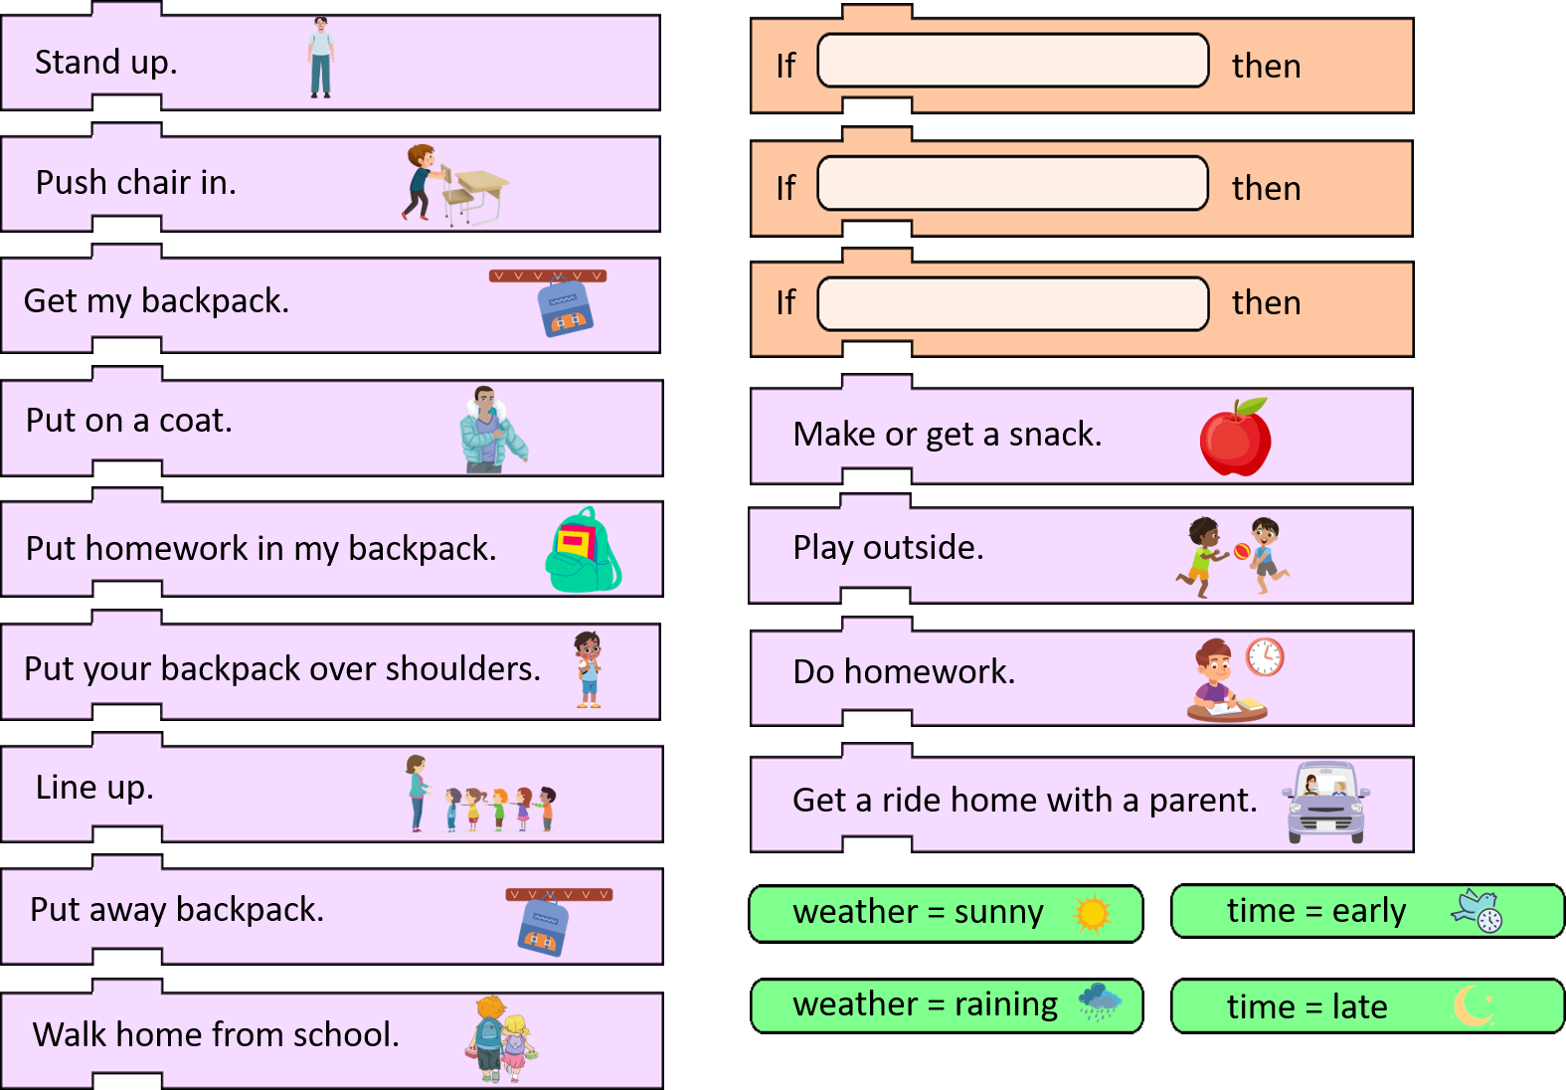
SEQUENCING is putting things in order.
An ALGORITHM is a step-by-step set of
instructions for solving a problem or for
completing a task in a certain order.
Your Task:
Copy and cut out the strips.
Place the green strips into orange strips.
Place the strips in an order.
Discuss the story by checking someone’s
ALGORITHM.
UNIT 1 … Coding – An Introduction
The Intent is to
show Activity #8
An Algorithm – End of the Day

Slide 8
UNIT 2: WALKING THE CODE
Let’s agree on 3 Special Cards in every sequence of code.
Always BEGIN every program with the card:
RECORD PROGRAM START
Always END every program with the card:
RECORD PROGRAM END
Always FOLLOW a program with the card:
RUN PROGRAM

Slide 9
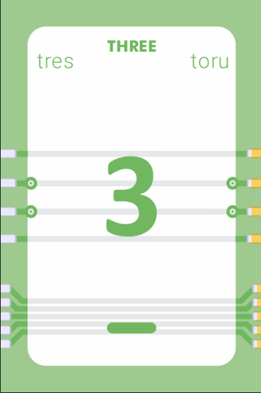
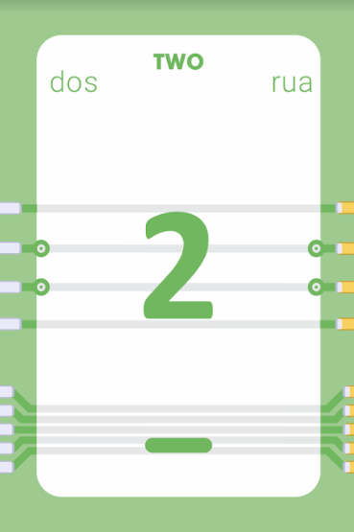
Learning takes place from the CONCRETE to the ABSTRACT.
Place cards on the ground or table in a specific sequence and then act out the commands.
KaiBot Coding Cards Template

Slide 10
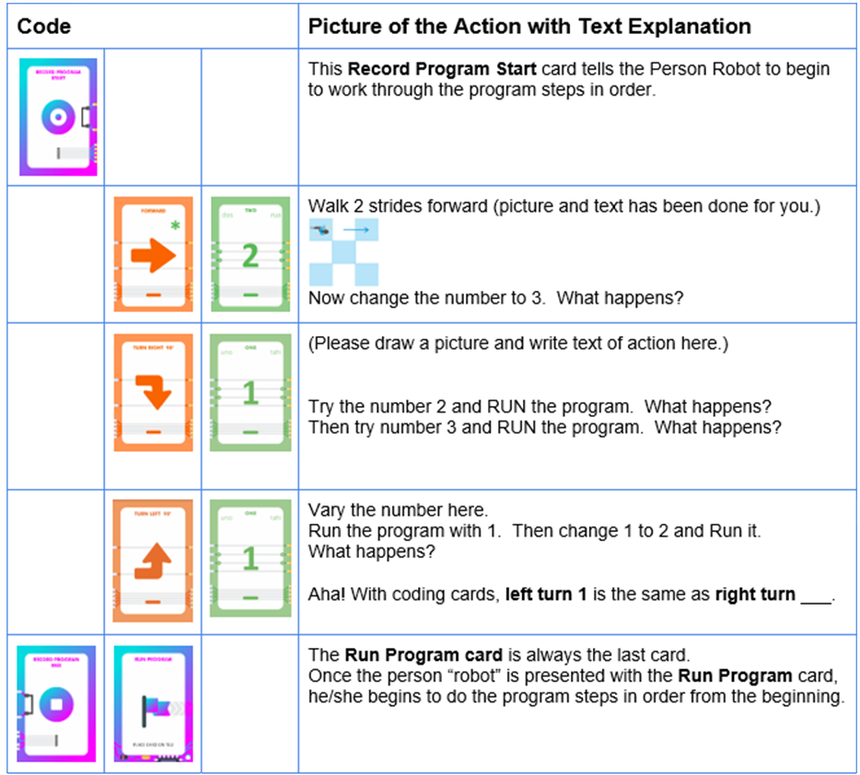
Task 3: Walk and Turn
You need two people: one Commander and one Robot.
The following sequence of cards forms a PROGRAM.
Arrange the cards vertically (up & down) as shown.
From the Activity Book
UNIT 2, Page 16
The INTENT here is to show where the student commander and the person playing the role of robot draw picture results and record text explanation of each step of code.
Commander lays out all cards in sequence for the person Robot.
When the robot sees the last card, Run Program, it walks the code.
Commander and Robot draw pictures and complete text explanation below.
Notes:
*

Slide 11
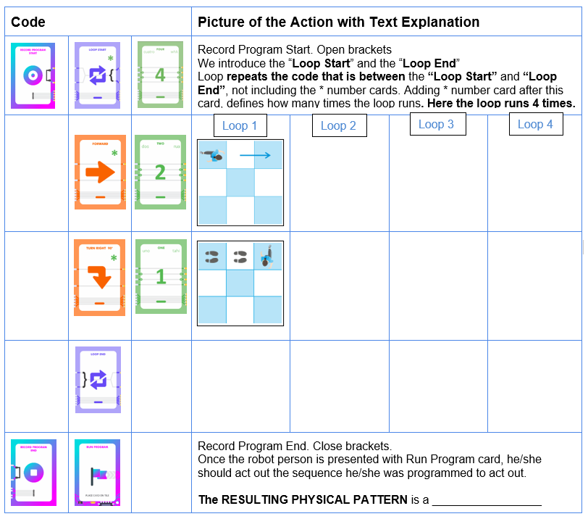
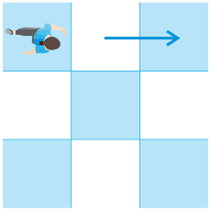
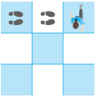
Task 11: Pattern - Pattern - Pattern
Commander thinks through the pattern in the program below.
Commander shows only the card code in sequence to the robot.
The Robot walks the code and fills in the pictures and text under Loops 2, 3, 4
Commander and Robot check and discuss action and pictures below.
Loop repeats code between these cards.
From the Activity Book
UNIT 2, Page 24
The INTENT here is to show where the Commander and the person Robot predict Robot Action & draw picture results and record text explanation of each step of code.
TOP VIEWS
Notes:
*

Slide 12
UNIT 3 Coding KaiBot
with Cards on KaiTiles
KaiBot is a small physical robot that helps learners understand coding through its actions.
KaiBot scans and interprets each Coding card
in the sequence.
KaiBot then executes specific code, leading to
corresponding actions.
The KaiBot is run on magnetic blue tiles called
KaiTiles for more accuracy.
We PREDICT, then TEST by coding KaiBot &
noting action in learning from mistakes.

Slide 13
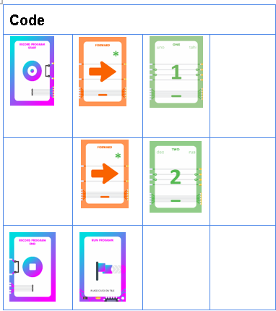
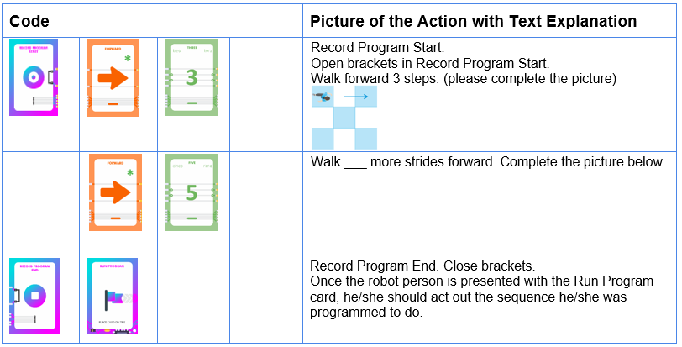
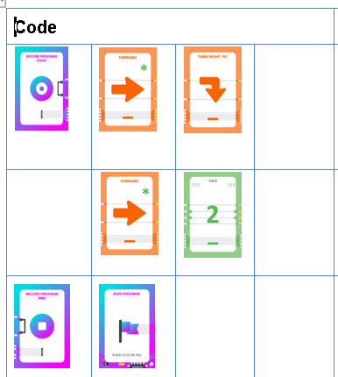
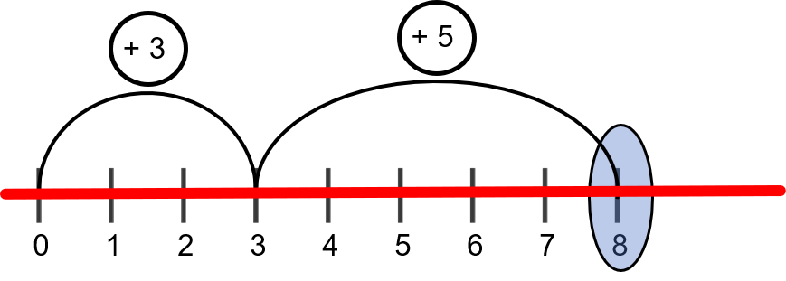
Program #4: Predict, then Test Addition
Then Try This
Commander adds cards for program below to model ADDITION.
Commander shows the code to the Person Robot.
The Robot draws a picture of the action, explains action and walks the code.
Discuss Key Talking Points below for the concept of ADDITION.
Now have KaiBot scan cards and test ADDITION.
From the Activity Book
UNIT 3, Page 33
The INTENT here is to show where the Commander and the person Robot predict Robot Action & draw picture results and record text explanation of each step of code.
Then Try This
Key talking points:
When the Run Program card is presented:
Person Robot starts at 0 on a number line when commander points at line 1 of code.
Then the Person Robot moves forward on the number line 3 STEPS.
Then the Person Robot moves forward on the number line 5 more STEPS.
The Person Robot STOPS and shouts, “I ended up at ______”
Repeat the above Task for many other number combinations.
Notes:
*

Slide 14
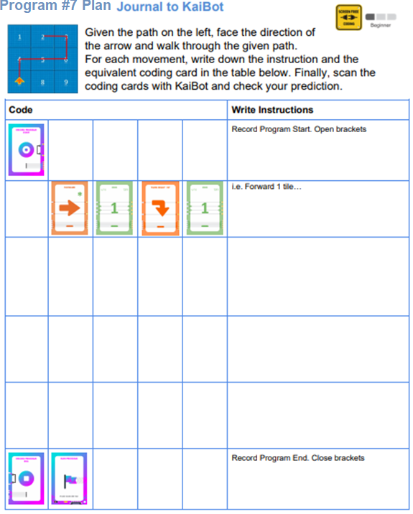
Program #10: Given Path - Predict, then Test with KaiBot
From the Activity Book
UNIT 3, Page 39
The INTENT here is to show where the Commander and the person Robot predict Robot Code to result in the path given and record text explanation of each step of code. Then Test with KaiBot
FIRST PREDICT
THE CODE
THEN TEST THE CODE WITH KaiBot.
Notes:
*

Slide 15
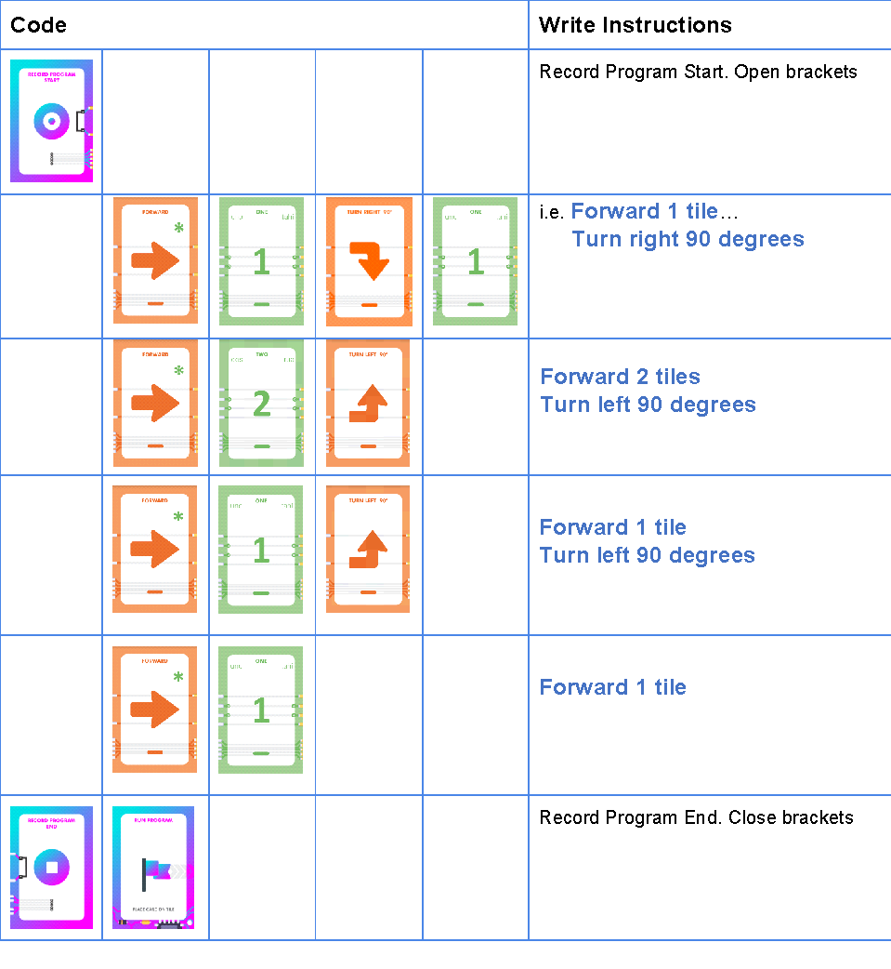
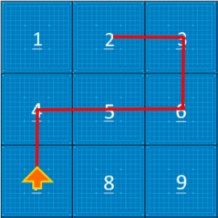
Program 10: Given Path – Predict, then Test with KaiBot - SOLUTION
d
c
a
b
a
b
c
From the Activity Book
UNIT 3, Page 39
d
Notes:
I think this is ok as is.. Can stay

Slide 16
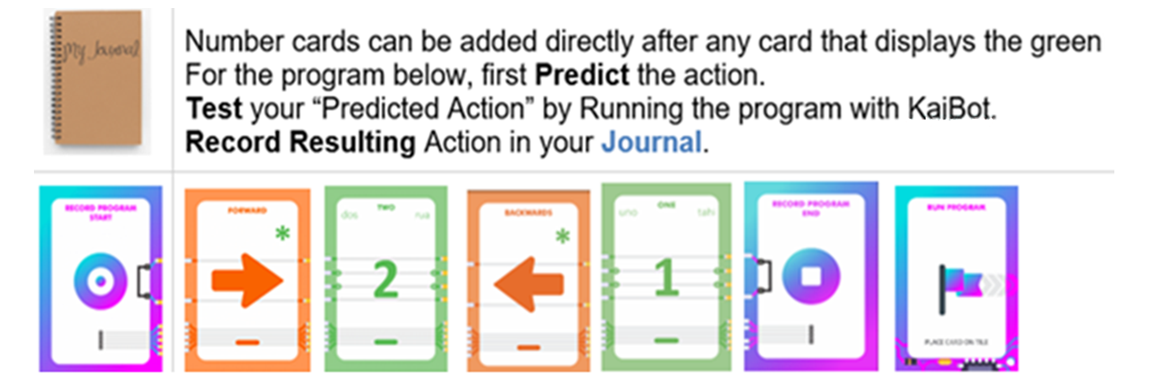
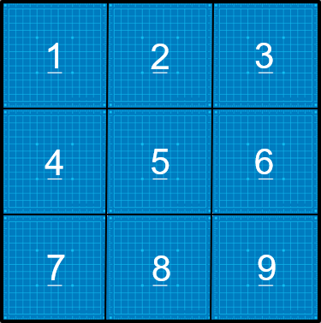
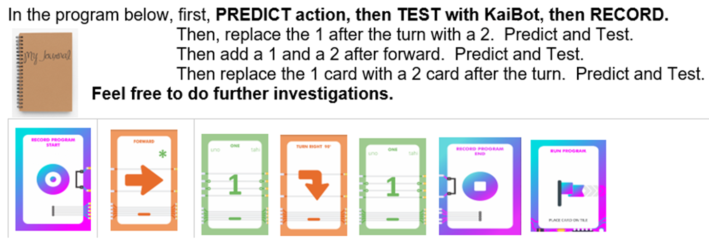
NUMBER CARD Pack and Investigation
In Review:
Notes:
This is an extra page .. It can stay

Slide 17
Hybrid: Use coding cards to code KaiBot and watch her in Kainundrum.
Unit 4: Loops
Understand Code for Loops
KaiTiles
Teach KaiBot to read your cards and then KaiBot will play back the actions on KaiTiles.
Use your coding cards to solve mazes
Add more KaiBots to join the race in multiplayer mayhem mode.
magnetic snap together
give location of KaiBot
assure accurate movement
Video to Review
Sequence
How to Scan
Detecting Bugs
Charging KaiBot
Using KaiTiles
Be sure SOUND OUTPUT is ON.

Slide 18
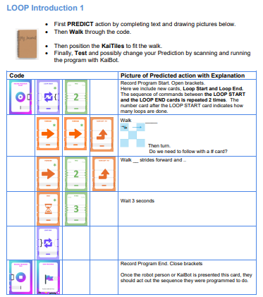
From the Activity Book
UNIT 4, Page 42
The INTENT here is to give the user a feel for the role of the LOOP START & LOOP END cards. Then use KaiBot to TEST their PREDICTION.

Slide 19
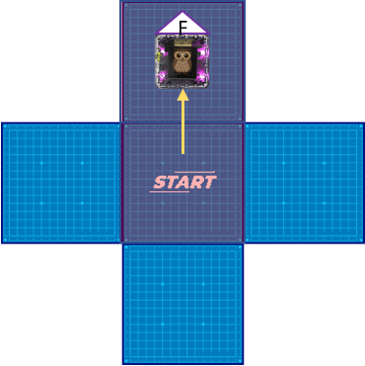
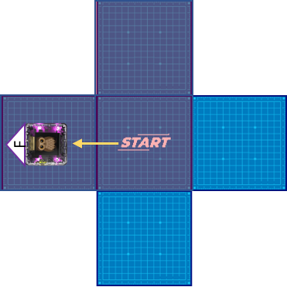
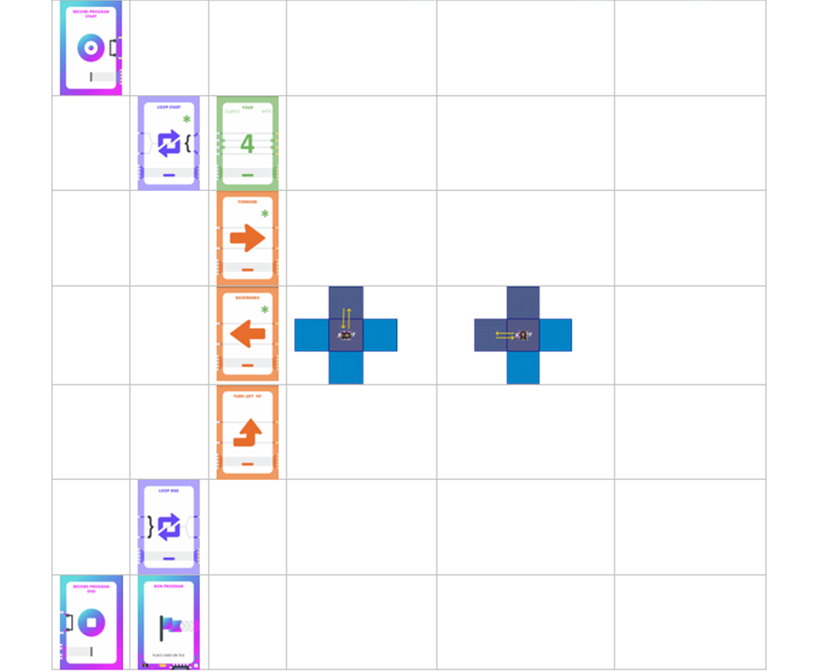
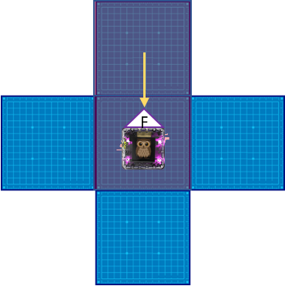
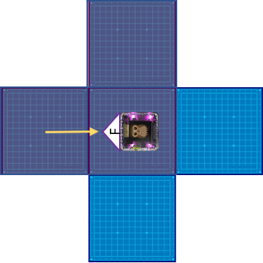
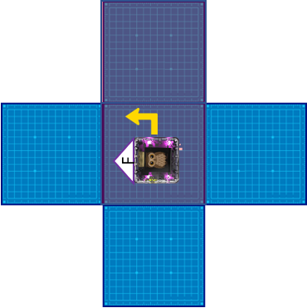
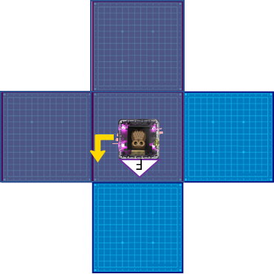
LOOP INTRODUCTION 3
(loop 1)
(loop 2)
The CODE
Predict Action
(loop 1)
Predict Action
(loop 2)
Predict Action
(loop 3) … etc.
From the
Activity Book
UNIT 4, Page 44
The INTENT here is to show in pictures the role of the 2 LOOP cards. Then use KaiBot to TEST their PREDICTION.

Slide 20
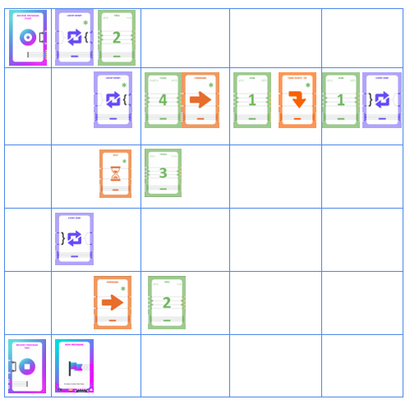
In UNIT 4 Extra …
Exercise WOW .. LOOP within a LOOP!
You are given the program in coding cards.
Cards are organized vertically to help in understanding.
First PREDICT and RECORD in the last column in book.
Then TEST your prediction by coding KaiBot.

Slide 21
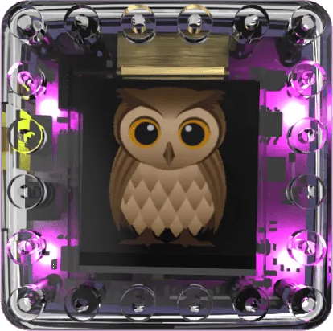
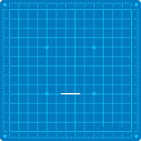
WOW .. LOOP within a LOOP!
This is the result of code on previous slide.
The INTENT here is to show the Path of the Action by KaiBot after Coding it.
F
1
2
3
4
5
6
7
8
9
F
F
After first loop
After second loop
To the End

Slide 22
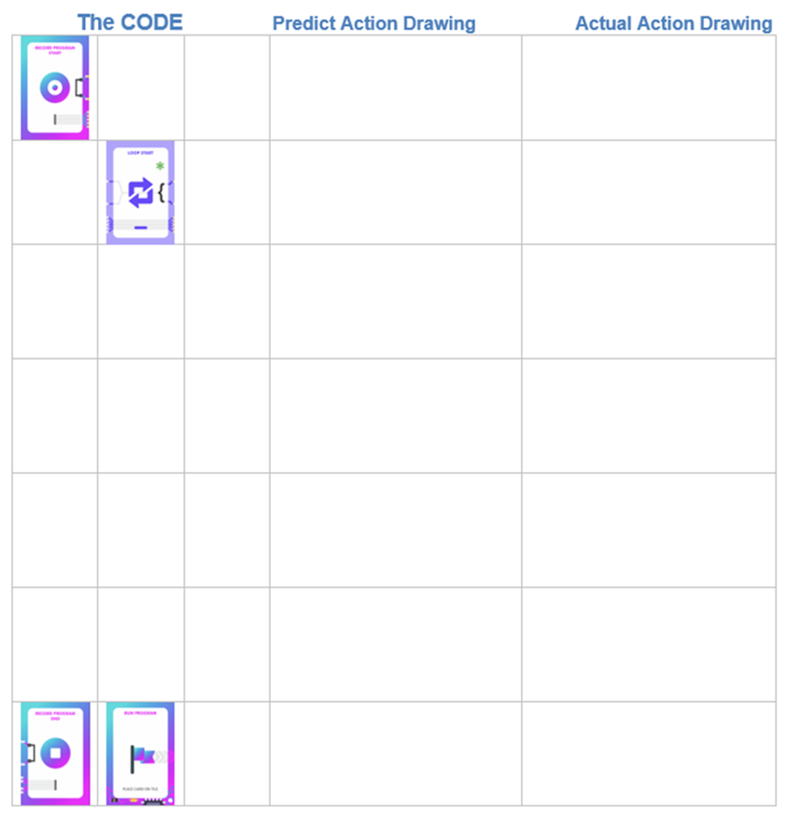
Program the Path
A sketch is given for KaiBot paths.
Look for Patterns!
In each exercise, note beginning and end.
For each path, predict and design a possible program with cards.
Test your coding with KaiBot.
UNIT 4, Page 57
Code | Code | Code | Draw Sketch and write Instructions
 |  |  | Record Program Start at tile #1. Open brackets
 |  |  | Move 2 Tiles Forward
 |  |  | Turn 90 degrees right
 |  |  | Move 2 Tiles Forward
 |  |  | Backwards …
 |  |  | Turn left …
 |  |  | Move backwards …
 |  |  | Move
 |  | ???? Must a Number Card be here?
 |  |  | Record Program End. Close brackets Once the robot person is presented this card, they should act out the sequence they were programmed to do.
Notes:
*

Slide 23
Code
The INTENT here is …
to give coding ideas
for:
UNIT 4, Page 67
Exercise 3 –
2
1
1
2
start
finish
Pattern 1: Going up the stairs
Pattern 2: Going down the stairs
Note:
Problem Solving by Chunking … breaking down a problem to smaller sections
…

Slide 24
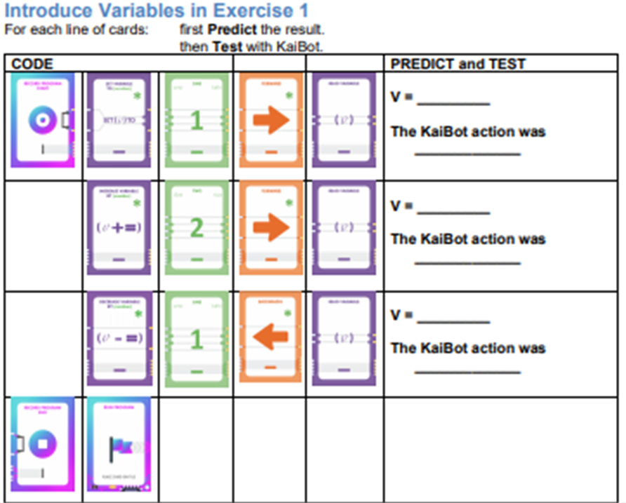
UNIT 5
SCREEN-FREE CODING
Variables & Conditionals
A VARIABLE is a symbol, often a letter, that represents different values in various situations.
From the Activity Book
UNIT 5, Page 62
The INTENT here is to understand VARIABLES and their changing values.
The user …
First PREDICTS
Then TESTS
Then ADAPTS & RETESTS.
After running KaiBot with the above, change the 1-card in the 2nd last row to a 4-card.
Predict .. Run It .. Explain It.
Notes:
*

Slide 25
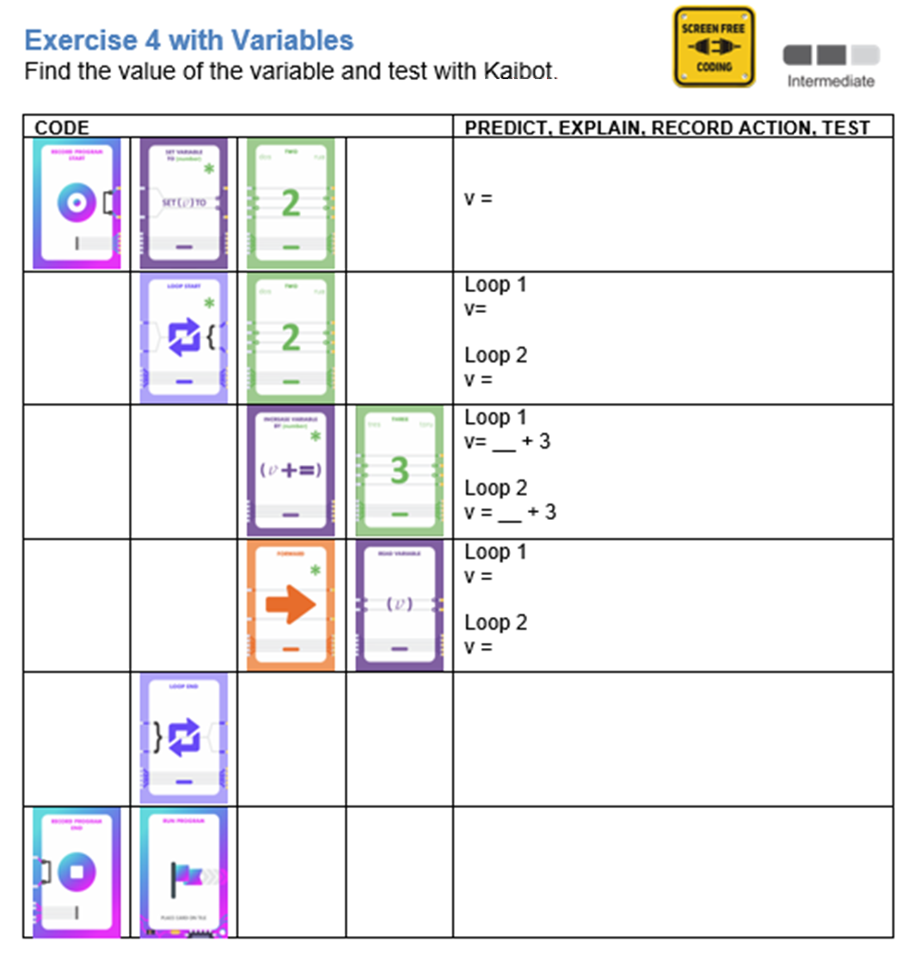
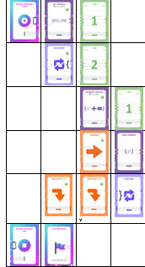
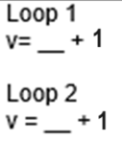
UNIT 5
SCREEN-FREE CODING
Variables & Conditionals
Similar to Activity Book
UNIT 5, Page 65
The INTENT here is to understand VARIABLES and their value and use within LOOPS.
The user …
First PREDICTS
Then TESTS
Then ADAPTS & RETESTS.

Slide 26
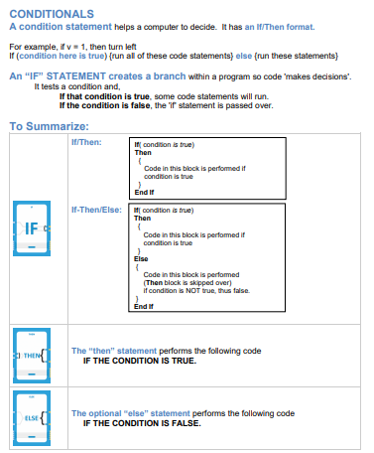
From the Activity Book
UNIT 5, Page 70
The INTENT here is to introduce the 4 commands within CONDITIONALS.

Slide 27
Similar to Activity Book UNIT 5, Page 71
The INTENT here is to TEST various situations with KaiBot and then
DISCUSS
what happens if:
ELSE is missing
ELSE is added

Slide 28
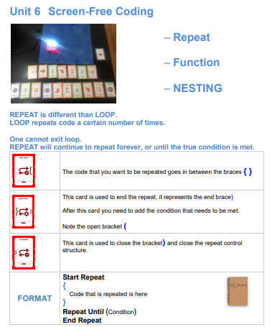
From the Activity Book
UNIT 6, Page 75
The INTENT here is to introduce the 3 commands within REPEAT.

Slide 29
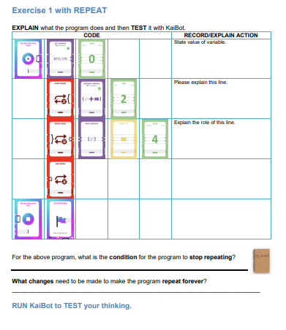
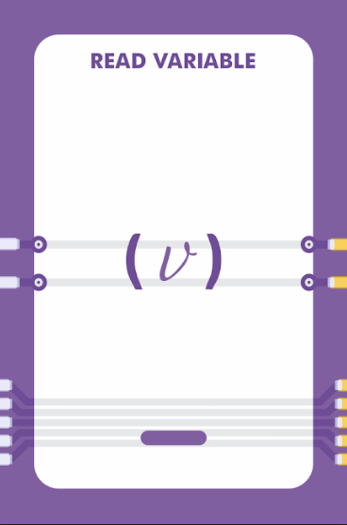
This is in Activity Book
UNIT 5, Page 76
The INTENT here is to TEST various situations with KaiBot and then DISCUSS what happens if the KaiBot follows the existing code.
TEST & DISCUSS the result if the following cards are added in cells 3 and 4 in line 4.

Slide 30
This is from Activity Book
UNIT 6, Pages 81, 82
The INTENT here is understand the role of FUNCTIONS and to have a glimpse at the how they interact with the MAIN Program.

Slide 31
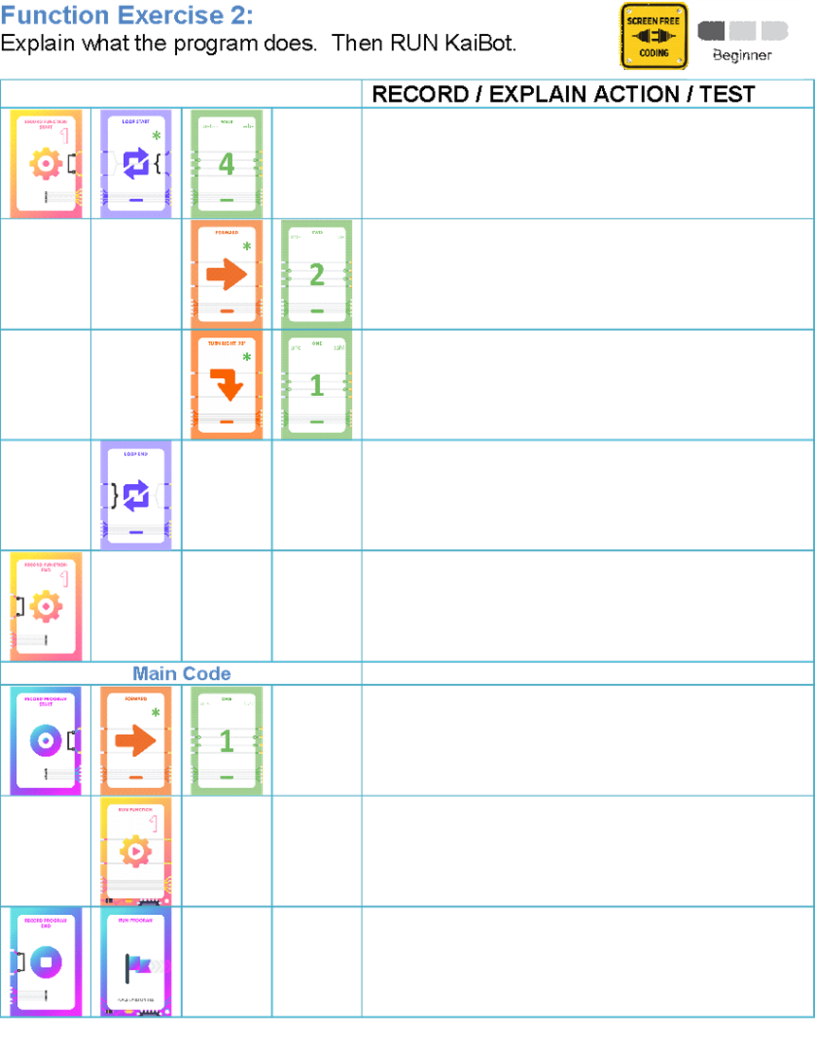
Function Code
This is from Activity Book
UNIT 6, Pages 84
The INTENT here is understand the role of FUNCTIONS and to have a glimpse at the how they interact with the MAIN Program.
Some solutions have been given.
Function start
Loop start 4 times
ACTION
Forward 2 tiles
1
2
3
Turn right 90 degrees
4
5
6
Loop End
7
8
9
Function End
10
11
12
Start Program
Forward 1 tile
Start
Call the function that moves in a square
Stop Program
Run Program

Slide 32
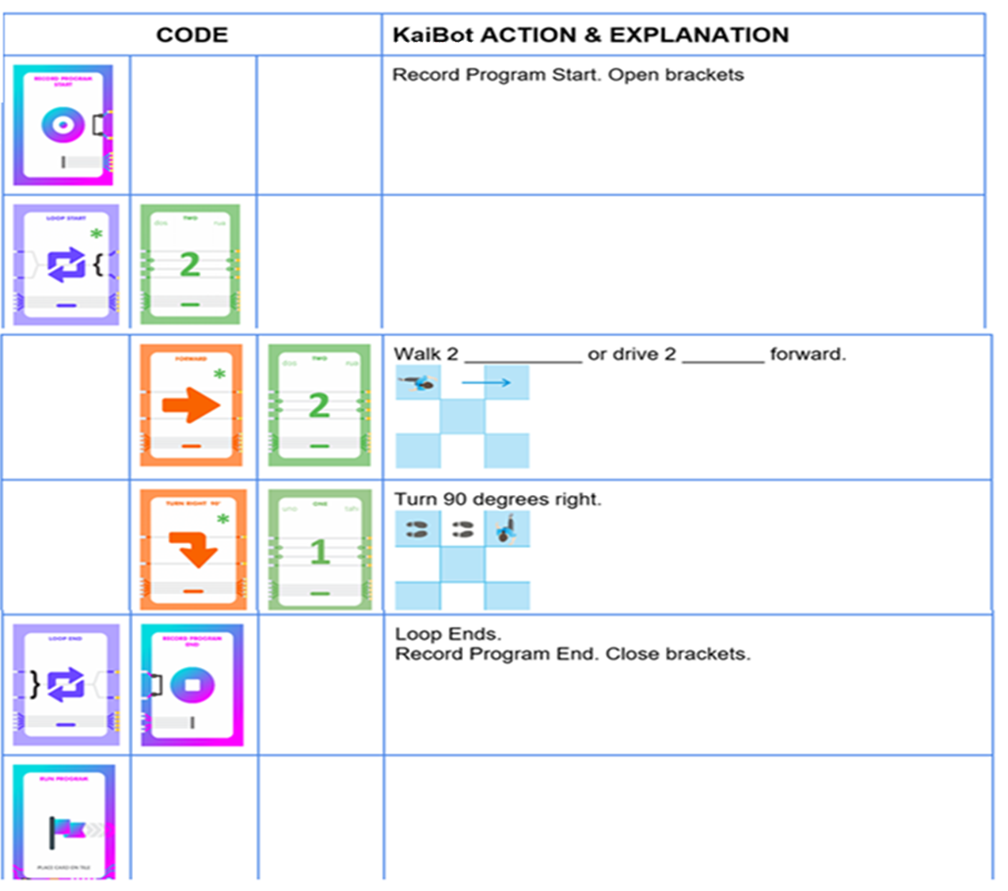
Unit 7:
The Transition .. CONCRETE to ABSTRACT
IN PREPARATION for the next slide, arrange your cards as indicated to the right.
We will SCAN these cards with a KaiBot on the next slide.

Slide 33
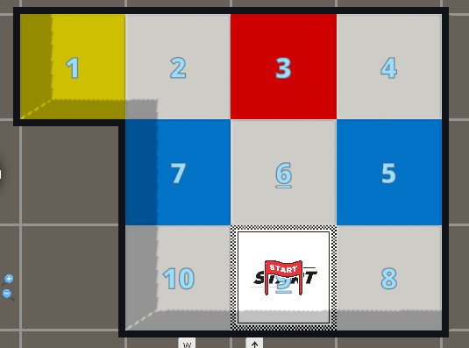
Coding from Concrete to Abstract
Process:
Match Tile Layouts – floor & screen
Then - Code KaiBot on the floor
- Virtual KaiBot on the screen
go to https://kainundrum.com and build the virtual layout
OR use Prepared Layout
https://kainundrum.com/work/work--dHapQj1tZt-HO2wG5xRG_5MM4nD8oZMY
OR
Prepared Layout
Build virtual layout

Slide 34
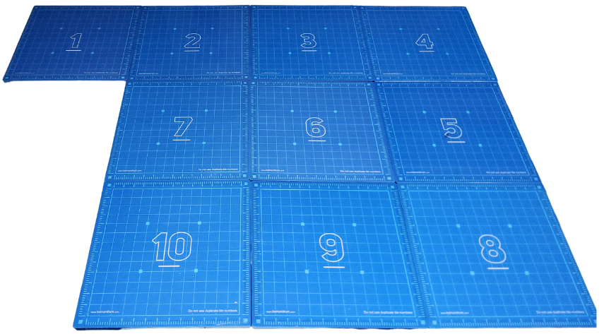
Process .. Coding Possibilities (cont)
2. Match tile layouts
Concrete on KaiTiles Virtual in Kainundrum
3. Save virtual layout
4. Pair KaiBot with Kainundrum by Bluetooth
5. Click on Start
6. Create a program by KaiBot scanning coding cards (see previous screen)
7. After Scanning KaiBot, program converts to Blockly & Python in Kainundrum ...
KaiBot acts the code on KaiTiles & mirroring in Kainundrum
After Scanning, user can run the program:
..by Cards to KaiBot (Concrete Action)
..by “Run Program” at the top of the Blockly Screen
Physical & virtual robots are mirrored
If tile layouts .. Concrete and Virtual .. are NOT matched, then Running Program in Blockly results in action ONLY on the 3D Virtual Screen

Slide 35
IN REVIEW
Kainundrum to
Blockly & Python
If the Virtual and Physical Tiles are an EXACT MATCH .. then
In the Concrete Phase one codes KaiBot on KaiTiles by scanning Coding Cards.
When KaiBot scans the “Record Program End” card, KaiBot sends the program through to Kainundrum.
In Kainundrum, program is converted to Blockly and to Python text code.
Virtual action results in the Abstract Phase.

Slide 36
IN REVIEW
NOTE: All following work can be done without the KaiBot (at no cost!)

Slide 37
IN REVIEW
If you DO NOT have the same tile setup on the KaiTiles and in Blockly, then movement will NOT be mirrored.
… however the result is acted out in the virtual 3D window

Slide 38
CHALLENGE 1 in Blockly: Given the Graphic below: First write and test the code with KaiBot and Coding Cards to result in graphic below. Then write Code in Blockly to result in the graphic below. Then test your work by running the program in Blockly.
The CONCRETE …Lay out Coding Cards, Scan with KaiBot and test the code.
The ABSTRACT … Code in Blockly, then run Blockly
UNIT 7 .. Page 106
Demo options here:
If virtual and physical
Tile setup are the same.
2. If virtual and physical tile
Setup are different.
This is an opportunity to demo building the Blockly Code
We progress to the Abstract Phase by coding a virtual KaiBot within Kainundrum
on the computer screen.
On computer … go to https://kainundrum.com and build the virtual layout
https://kainundrum.com/work/work--dHapQj1tZt-HO2wG5xRG_5MM4nD8oZMY

Slide 39
Following Mazes are Examples of: Game-Based Learning through Coding for grade 6++ We CREATE through a free Kainundrum https://kainundrum.com We then build the virtual layout. We can … CREATE a game through coding. … CHALLENGE someone to SOLVE a game through coding.
Kainundrum is an innovative, exciting, game-based platform that will also let players unleash their creativity and puzzle solving skills through designing and playing games.

Slide 40
Create and Play a Game: Game 1: Maze Project 1
Creation
Overall Objective:
First create the maze race in the Level Editor of Kainundrum
Then challenge someone to find a path to the Finish
First create the maze race using the instructions below or use Maze Race 1
https://kainundrum.com/work/work--3X00UrR4KdF98TP5hEzoo4hSHx0oh6mx
Step 1:
Create 6 x 5 tile layout, Maze Race game
Add Start ( ) and Finish ( ) tile objects by selecting ( ) on the side menu.
Add walls ( )

Slide 41
Maze Project 1 – Solution (cont…)
Test the Blockly Code given, then test your own solution.
Start to Tile 25
Tile 25 to Tile 21
Tile 21 to Tile 23
Tile 23 to Tile 11
Tile 11 to Tile 12
Blockly Solution
https://kainundrum.com/work/work--zdAw1EgJdFwf6bVFfEjDQcbG1S8wadnq
Tile 12 to Finish

Slide 42
Maze Project 3 – Solution (cont…)
Please note that the functionality of Kainundrum may differ from the time of writing this book; therefore, the code shown in this demo is be slightly altered.
Path2 Pick up object function
Turn on electromagnet to pick up objects
Start to pick up the red balloon to Tile 5
Tile 5 to collect the coin, then to Finish
Blockly Solution in Kainundrum
https://kainundrum.com/work/work--l2gZFoIXwdmi4NmEBGGG1w4H5xmTz2A8

Slide 43
Following are Examples of Coding within Gr 6+ Curriculum.
Chinese Nested Boxes
by Blockly
Click on the link below:
https://kainundrum.com/work/work--BwYcIPH3L0zbPBnn9wAFR_PUvLpVzlfj

Slide 44
Blockly Code to Generate a Regular Polygon
First think through the Blockly Code on the left and the resulting Octagon on the right. Try to understand.
Then click on the link below, then test the given Blockly code and check the virtual KaiBot path .. and REGULAR OCTAGON
Then challenge each other to write blockly code to create a REGULAR HEXAGON.
https://kainundrum.com/work/work--HGrBna1f86fqJn-5n0_HPyzYh6KGRcjn

Slide 45
Blockly Code to Generate Regular Polygons
Challenges
See the blockly code on the left. Try to understand the resulting shapes on the right.
Run the code below and try to understand the action
https://kainundrum.com/work/work--sWCFlOO0gZ-cNjcX30Hv7Talerfg-O31

Slide 46
Getting Started … The Startup Pack
https://www.umathx.com/shop
The Package:
A Single KaiBot with basic coding cards
Coding cards – advanced
100 different cards from Movement, Logic, Numbers,
Loops, Variables, Repeats, Functions, Nesting etc.
Magnetic KaiTiles
Packs of 10 for KaiBot movement & accuracy.
Lesson Plans in Activity Book (K to 5+) & Powerpoint
.. “First Steps in Coding” RudyNeufeld@umathx.com
.. This powerpoint for gr 2 to 8 workshops www.umathx.com
go to https://kainundrum.com
Access to FREE TO CODE & PLAY with virtual robots and blockly

